Slide 1
BrokersBunch GROUP NO : 23
Presented By : Khadija nadiadi (17BCA075)
Nayshree pachori(17BCA103)
Nishant jain(17BCA138)
Internal Guide : Ms. Nithya nadar External Guide : Mr. Abhishek shah

Slide 2

Company Profile
⮚ Company name: Hauper Technologies.
⮚ Company address : 501, Shivalik Shilp, Near Iscon Circle, Sarkhej - Gandhinagar Hwy, Ahmedabad, 380015
⮚ Contact number: +919978707853

Slide 3
About Company
Hauper technologies is a web design and development company established and located in India.
It was founded to address the core problem in the IT industry of lack of passion about creating products.
They convert ideas to realities. We give insights and advice about
the product itself.
They are always in quest of finding people with whom we can build a product that has utility.
The company is always ready to provide its Customers with original design ideas, robust and scalable applications, dedicated technical assistance and support.

Slide 4
Proposed System
This web application provides a common platform for broker and client to sell or buy properties.
ADMIN
The Admin can register his account by entering the username, email address and password and login himself by using those email id and password.
He/she can verify / add or delete the Broker details.
He/she can change the status (Sold or Unsold) of properties and perform required actions.
He/she can view and manage the feedbacks provided by brokers or clients.
He/she can view the payment details.

Slide 5
Broker
The Broker can register his account by entering the username, email address and password and login himself by using those email id and password.
He/she can update his personal details from the Update profile tab in his profile.
He/she can upload the property details of the property (Apartment or Tenament) which he wants to sell.
He/she will receive the appointment fixed by the client for a particular property. He/she can cancel or reschedule the appointment.
Once the payment is done the Broker will receive the commission through the platform.
He/she can view the payment details.
Client
The Client can register his account by entering the username, email address and password and login himself by using those email id and password.
He/she can update his personal details from the Update profile tab in his profile.
He/she can search the properties (Apartment or Tenament) whichever he wants to buy.
He/she will fix the appointment for a particular property. He/she can only be able to cancel the appointment.
He/she can initiate online payment for booking an appointment.
He/she can view the payment details.

Slide 6







TOOLS AND TECHNOLOGY USED
PHP
JavaScript, CSS
HTML, Jquery, Bootstrap
MySQL
XAMPP
MS Office 2016, draw.io
⮚ Front End :-
Back End :-
Server:-
⮚Other Tools :-

Slide 7
HOMEPAGE
This page will let the user gets an overview of website through accessing the tab like AboutUs.
This page also have feedbacks section which will help user to build more trust .
This page also have chat option so user can solve any sort of query.

Slide 8
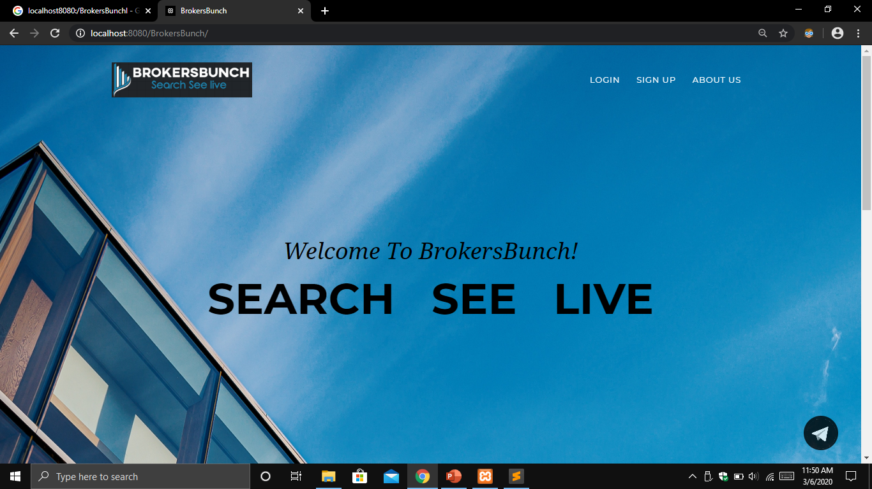

Slide 9
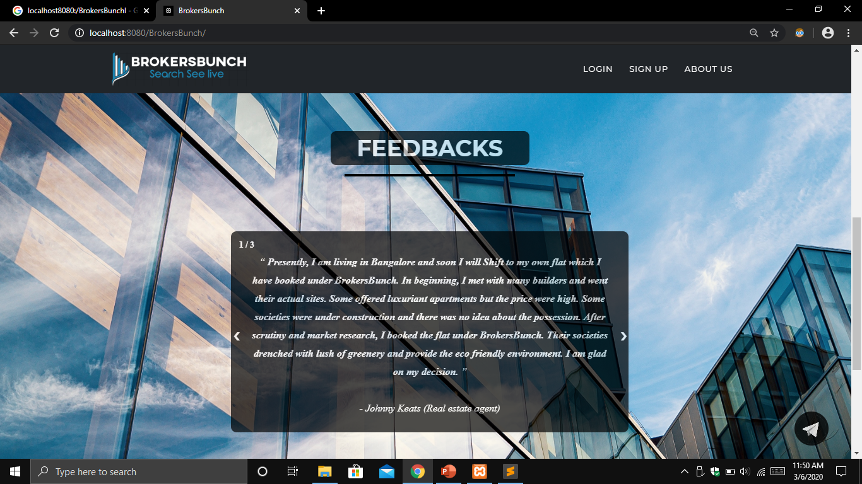

Slide 10
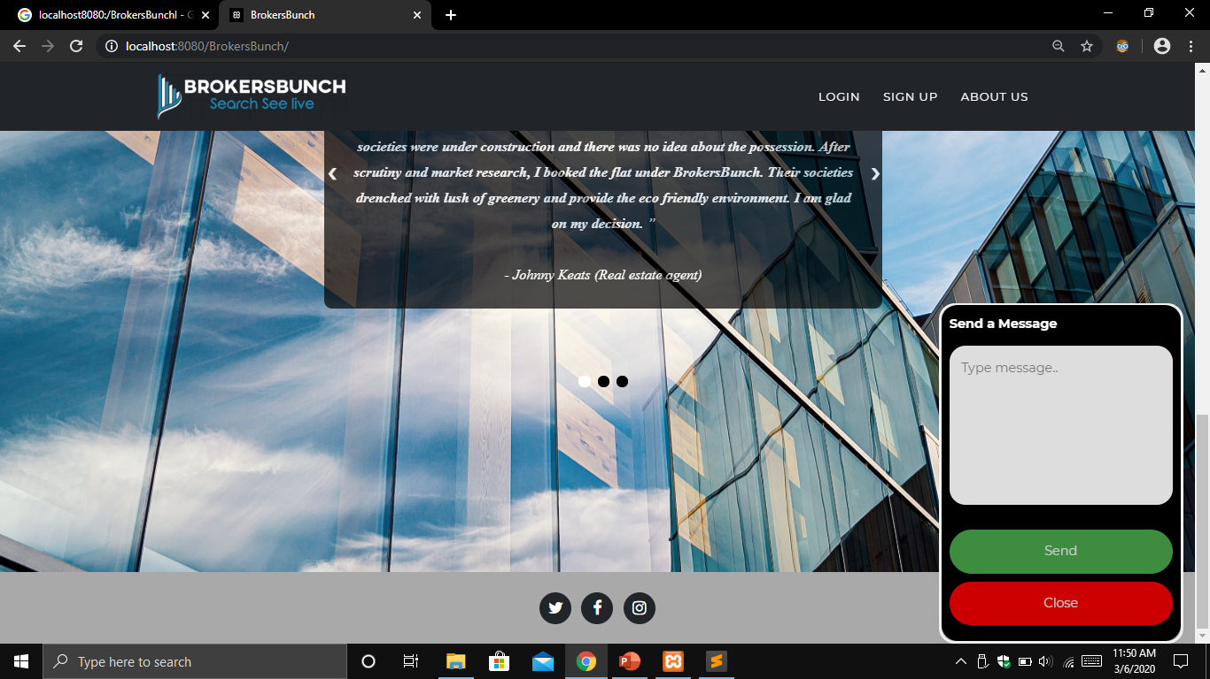

Slide 11
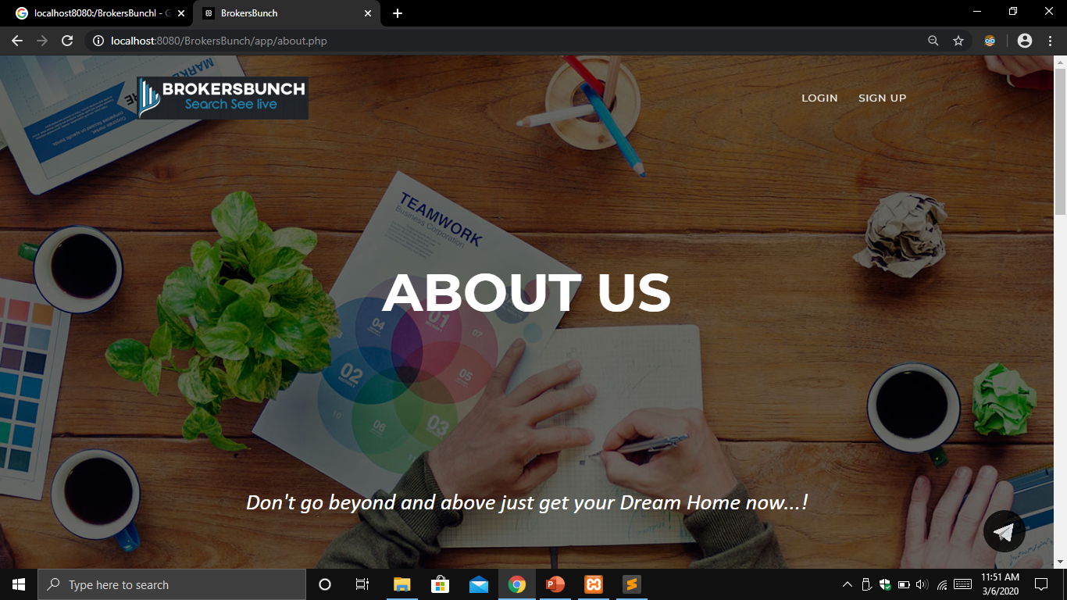

Slide 12
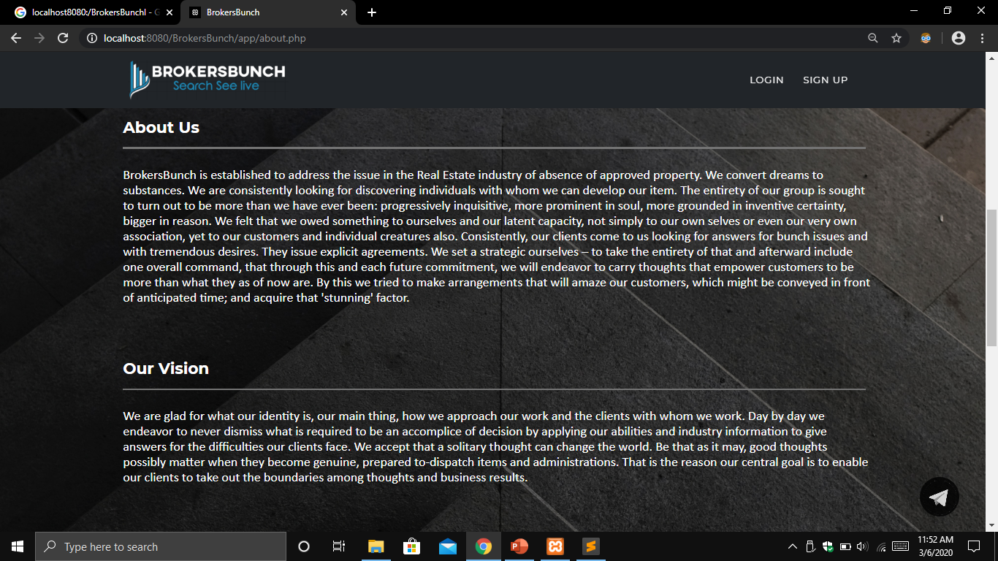

Slide 13
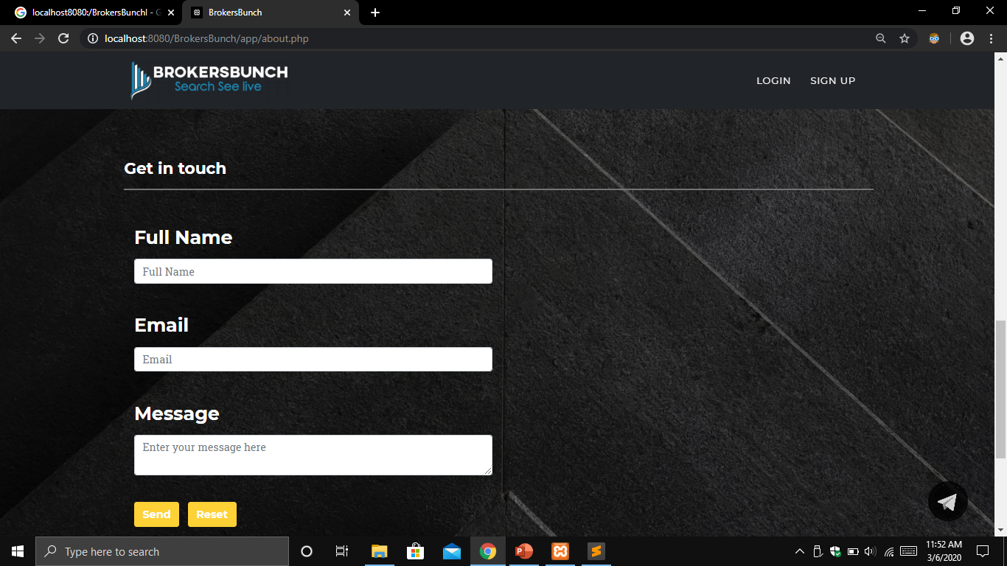

Slide 14
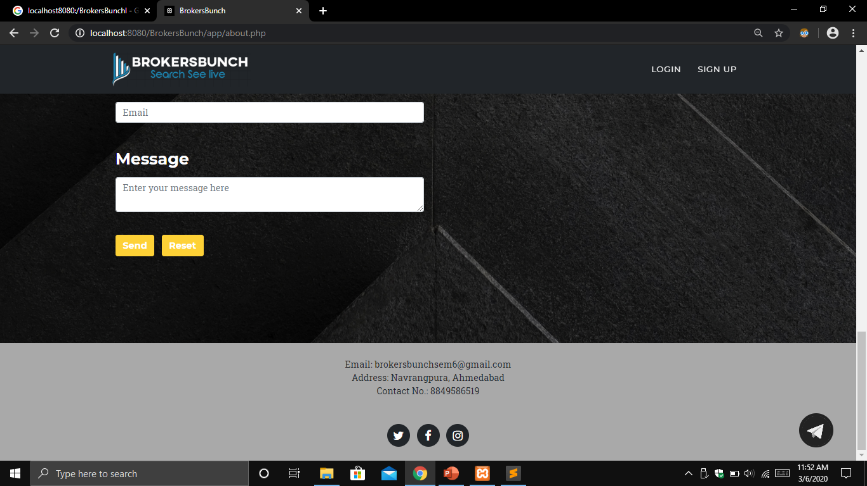

Slide 15
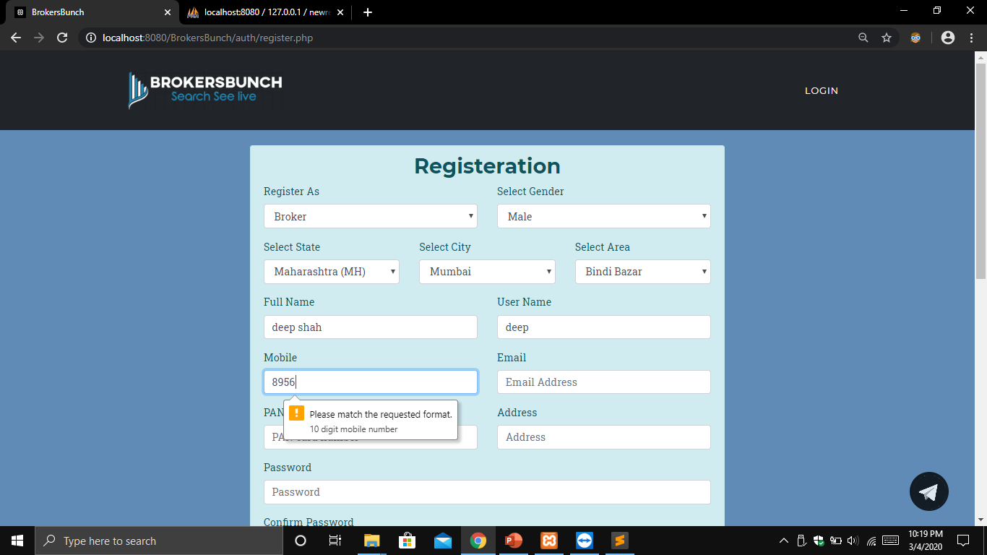

Slide 16
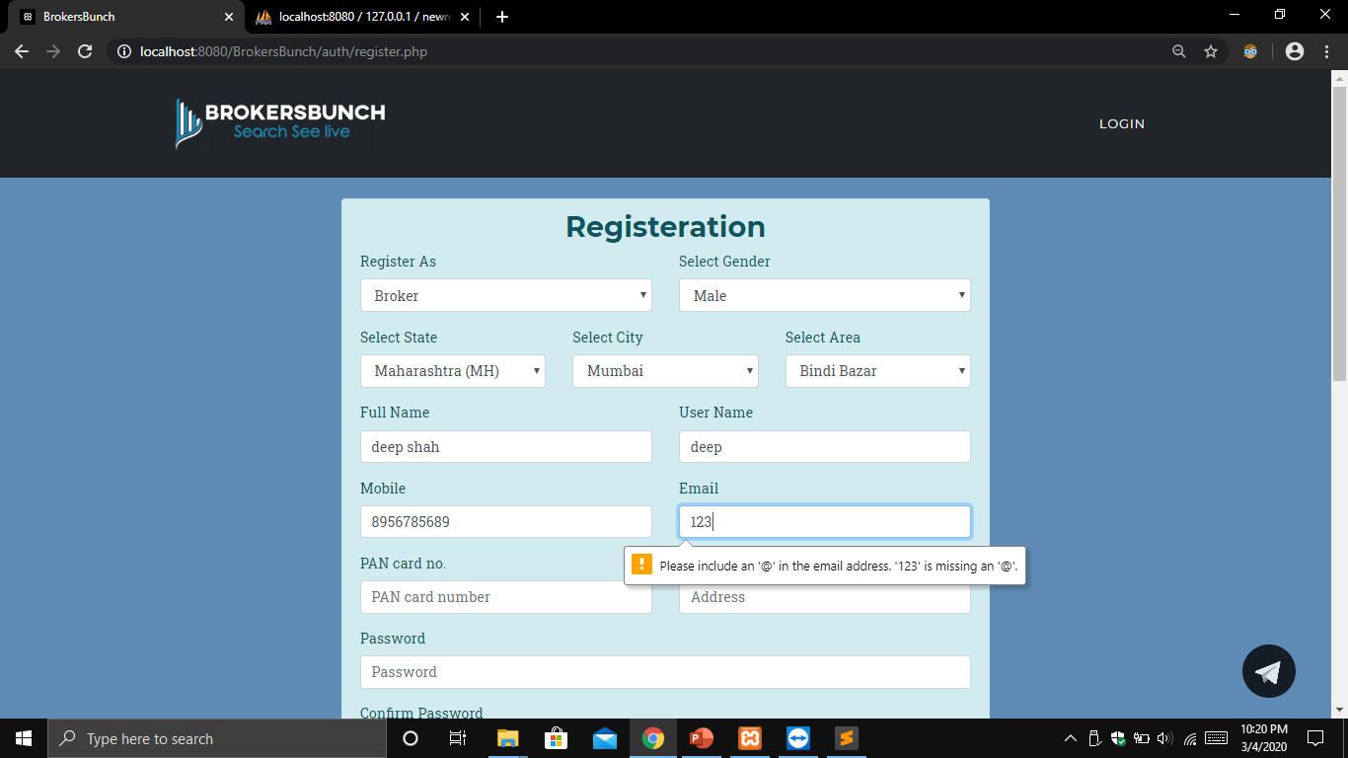

Slide 17
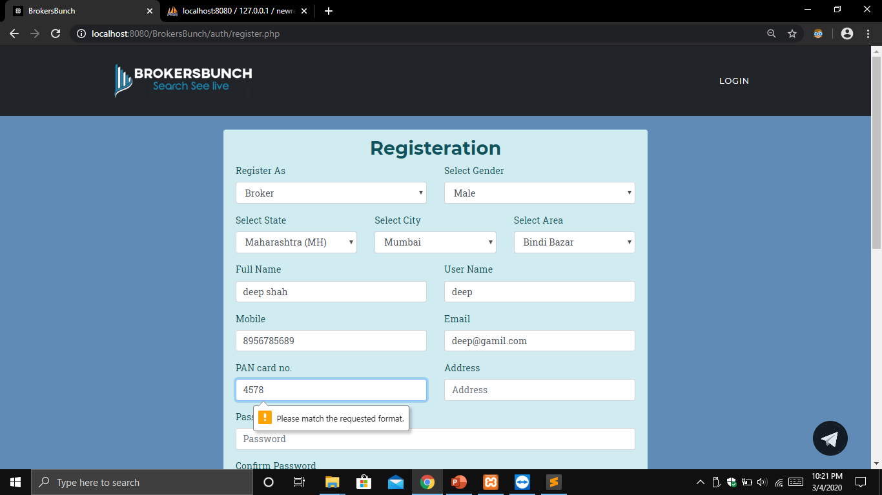

Slide 18
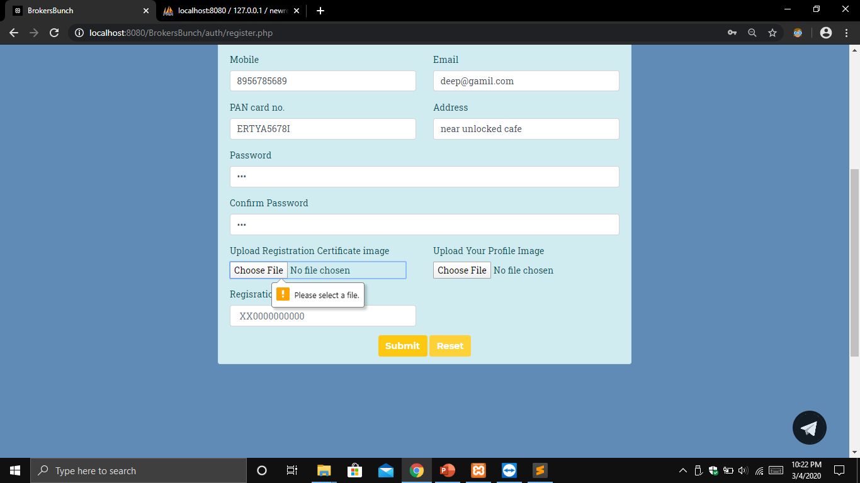

Slide 19
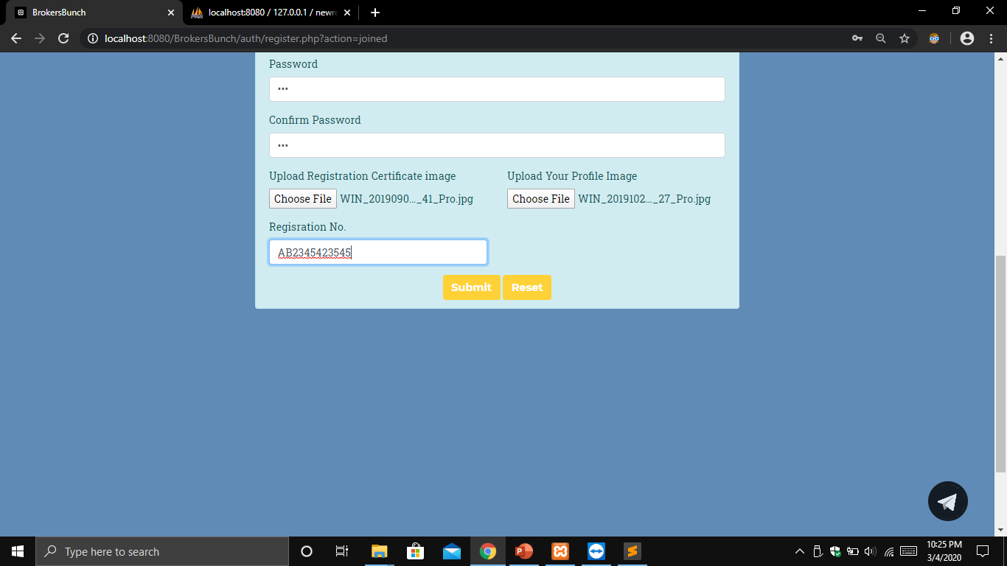

Slide 20
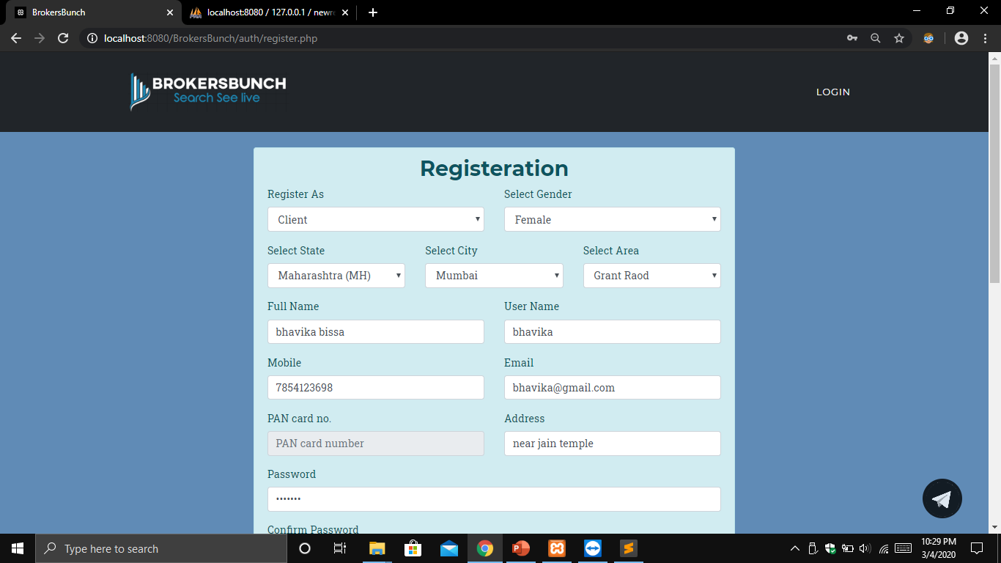

Slide 21
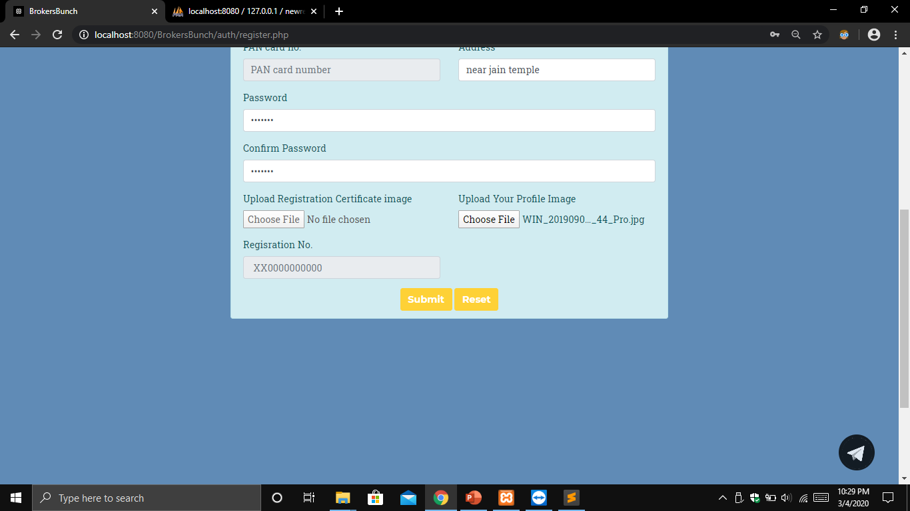

Slide 22
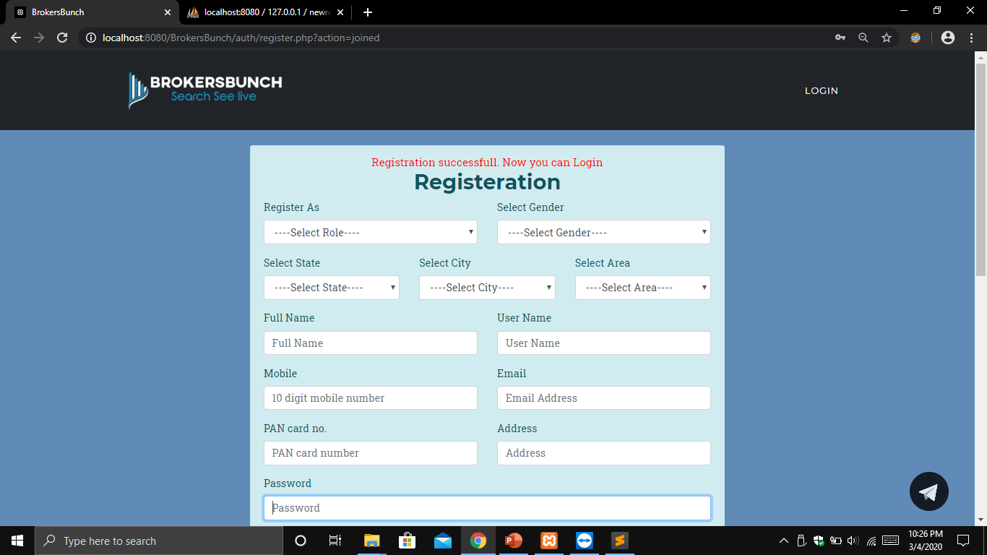

Slide 23
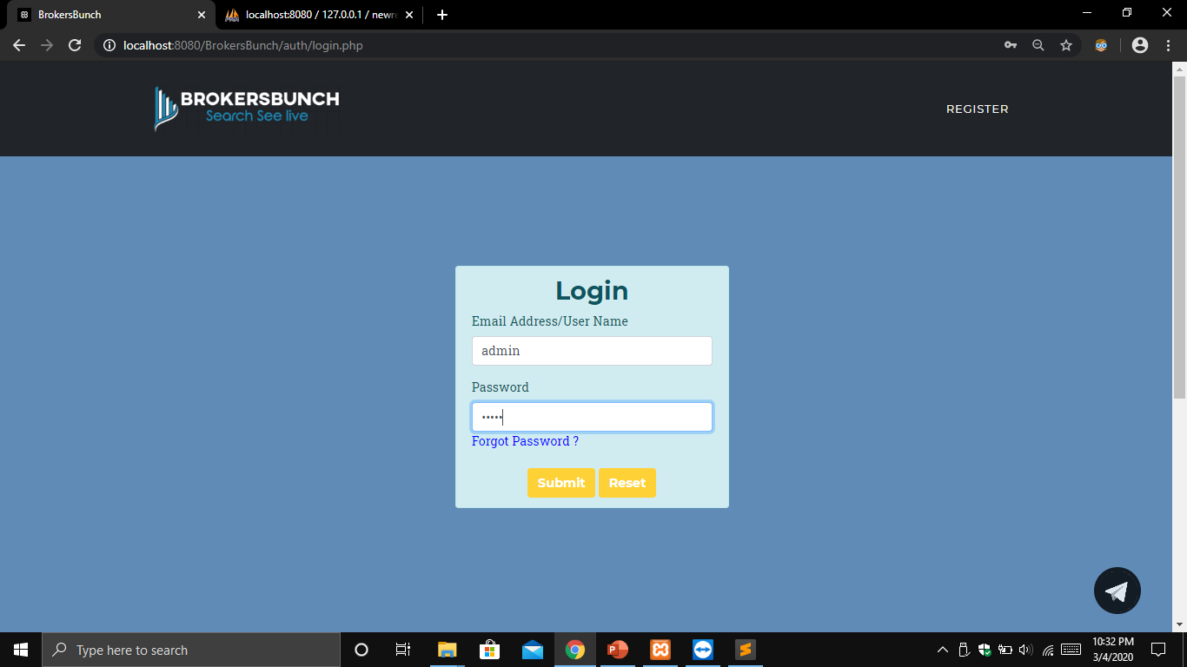

Slide 24
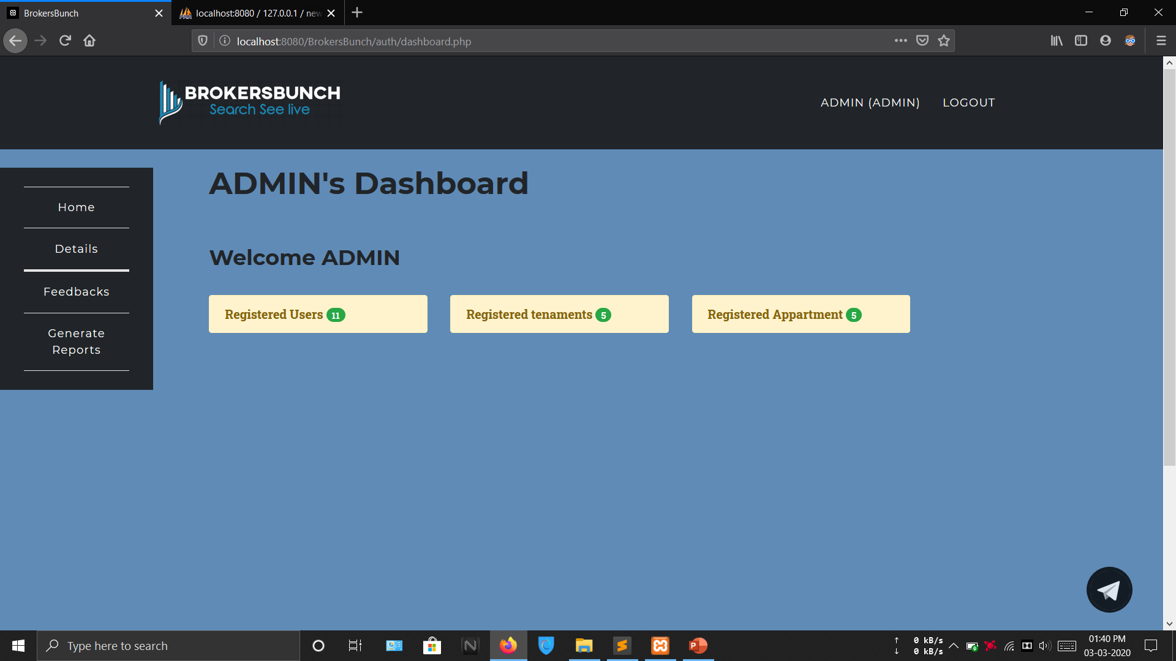

Slide 25
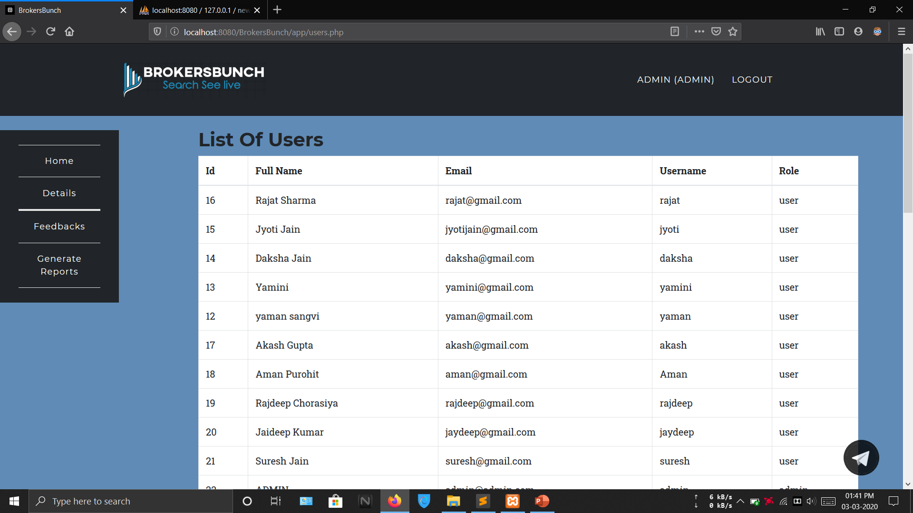

Slide 26
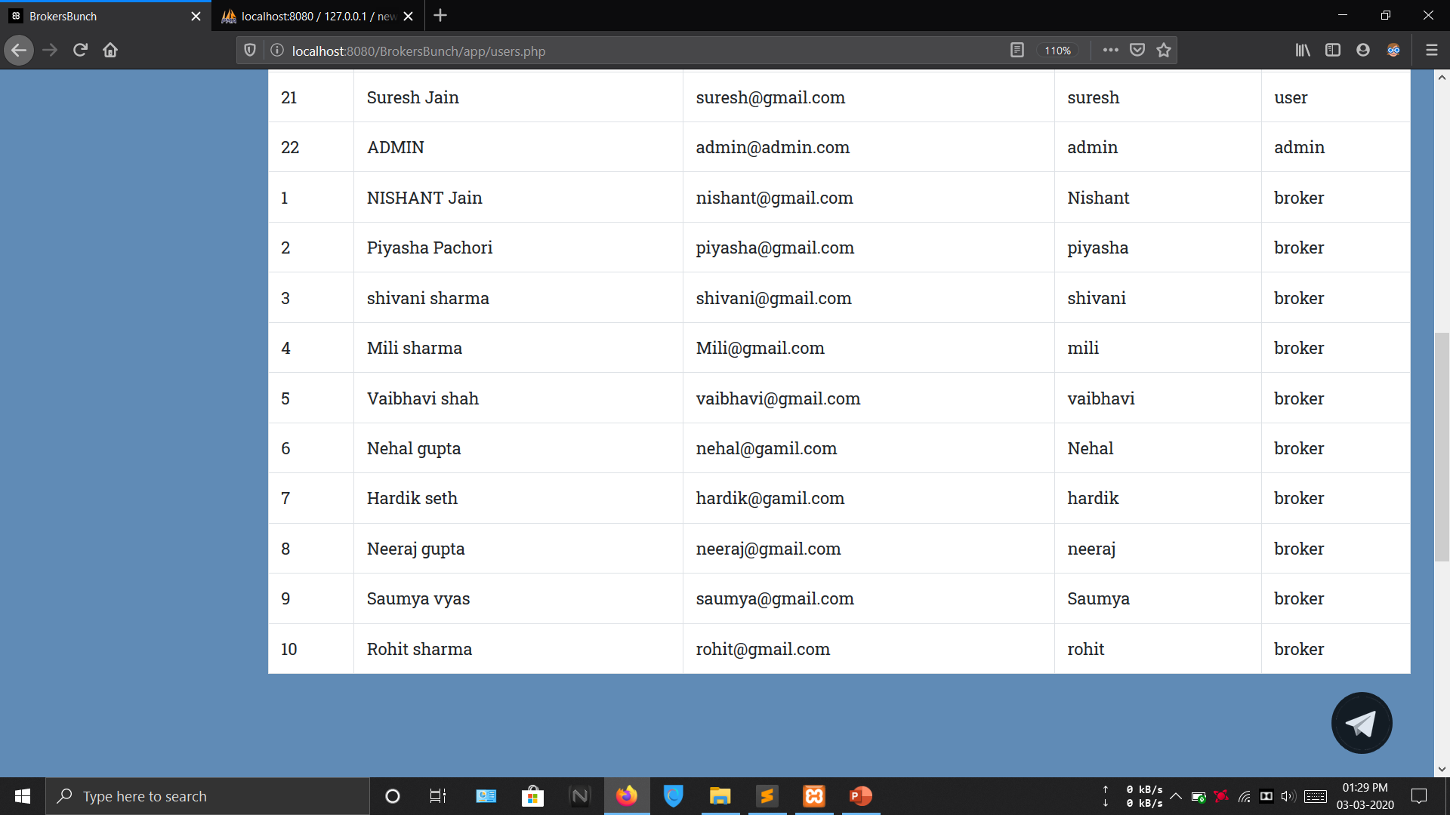

Slide 28
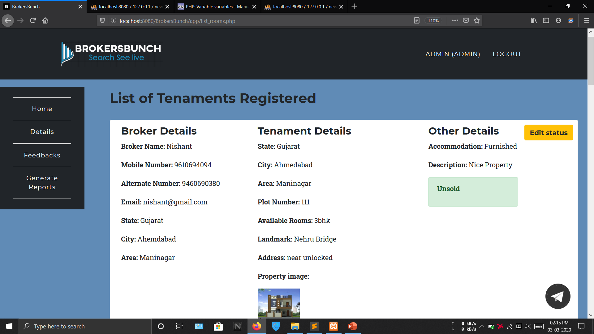

Slide 29
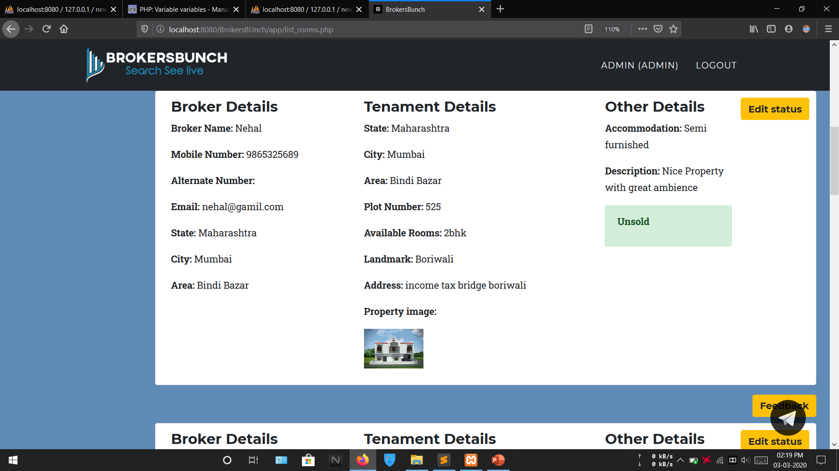

Slide 30
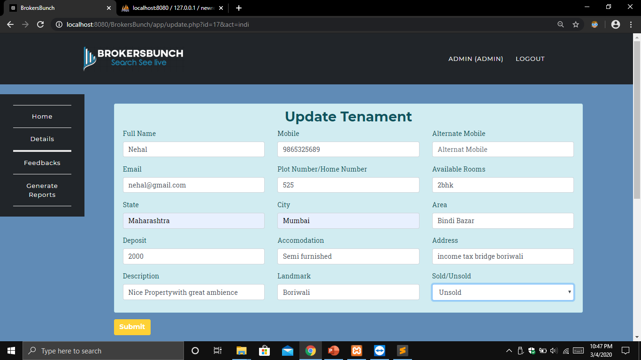

Slide 32
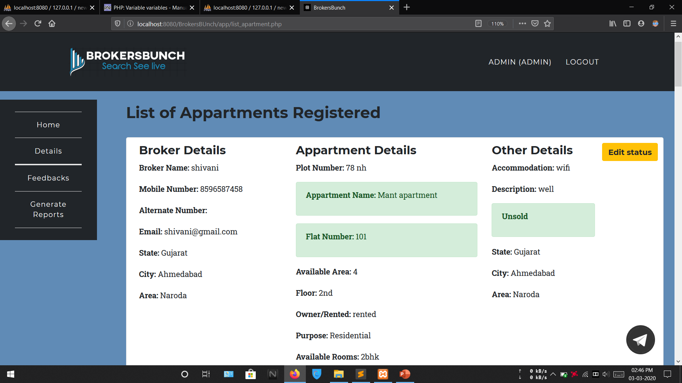

Slide 33
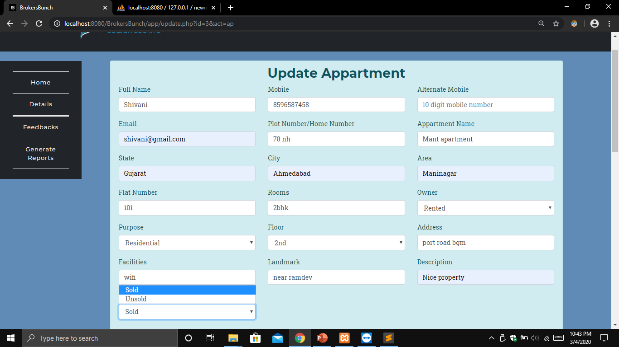

Slide 34
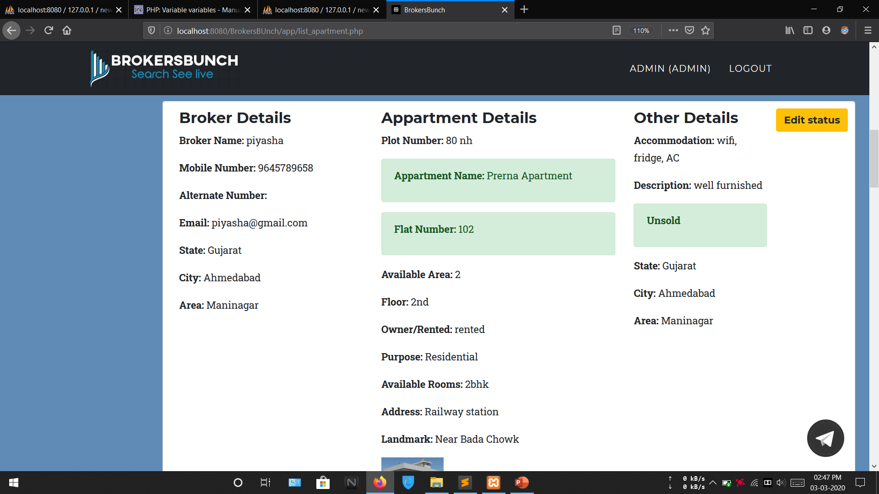

Slide 35
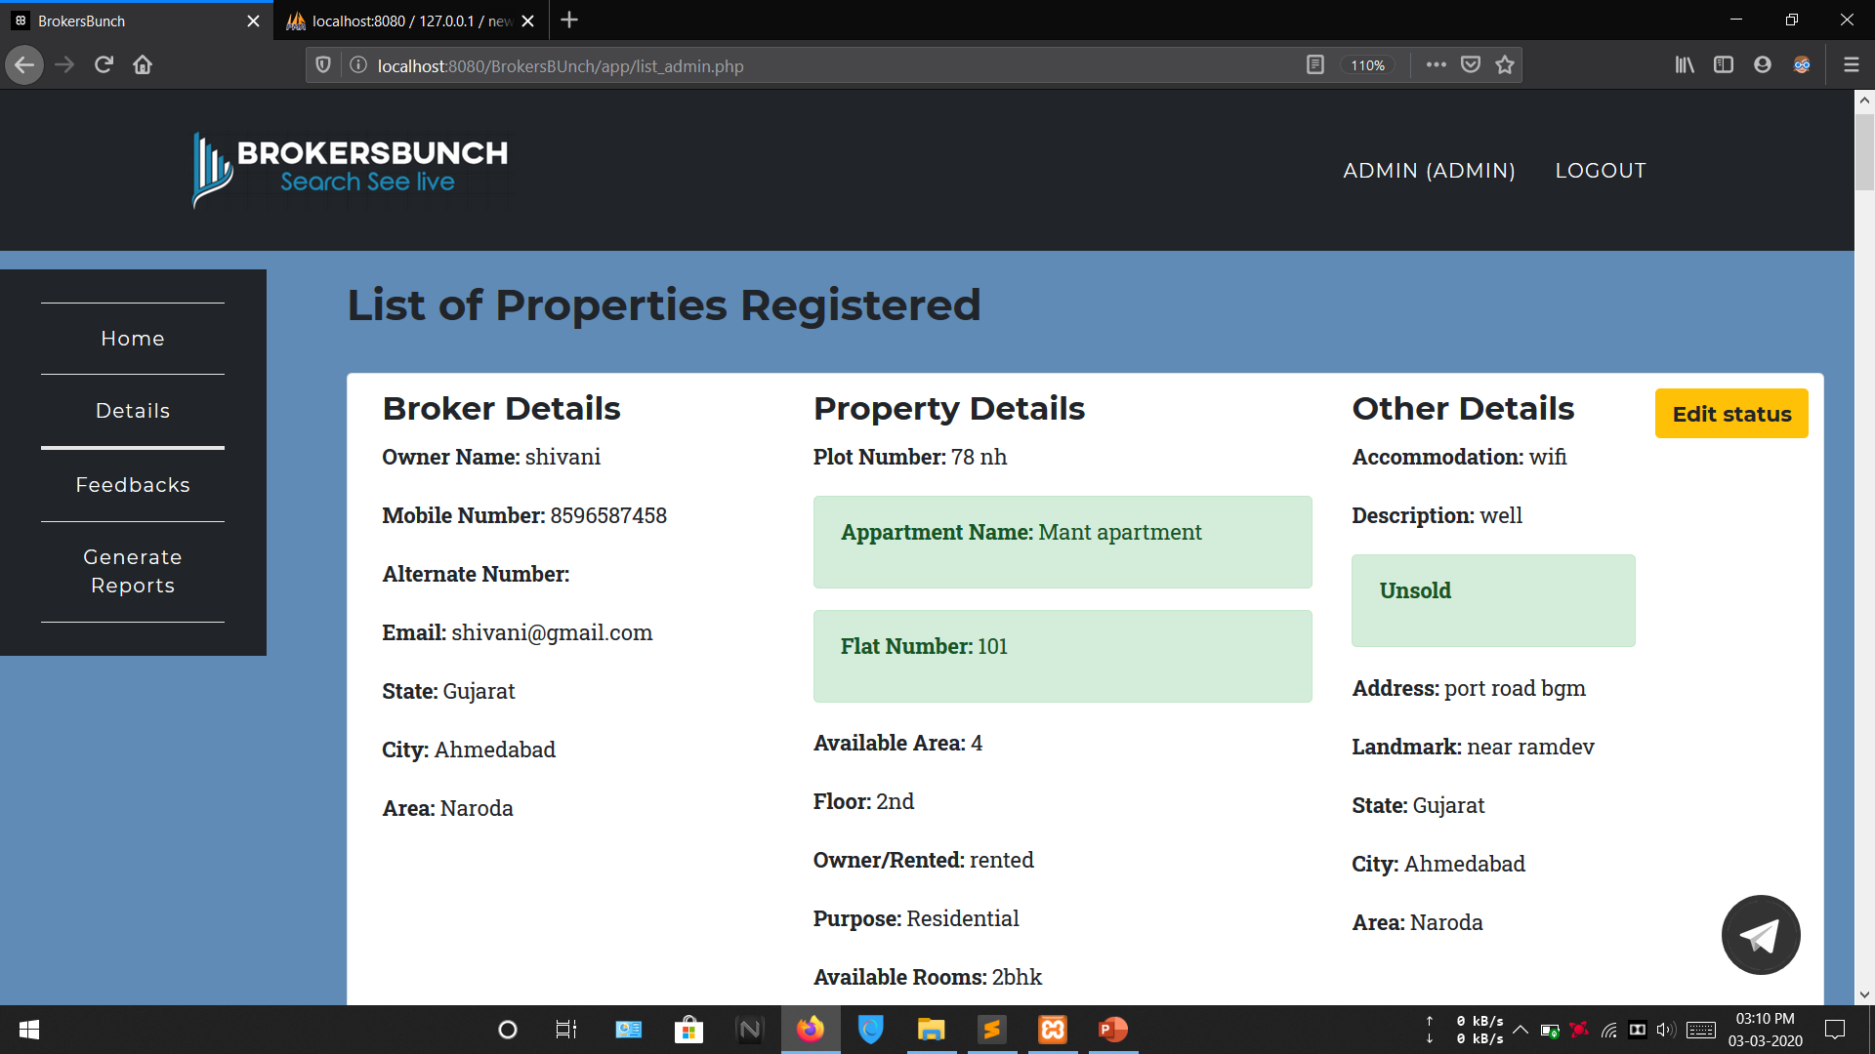

Slide 36
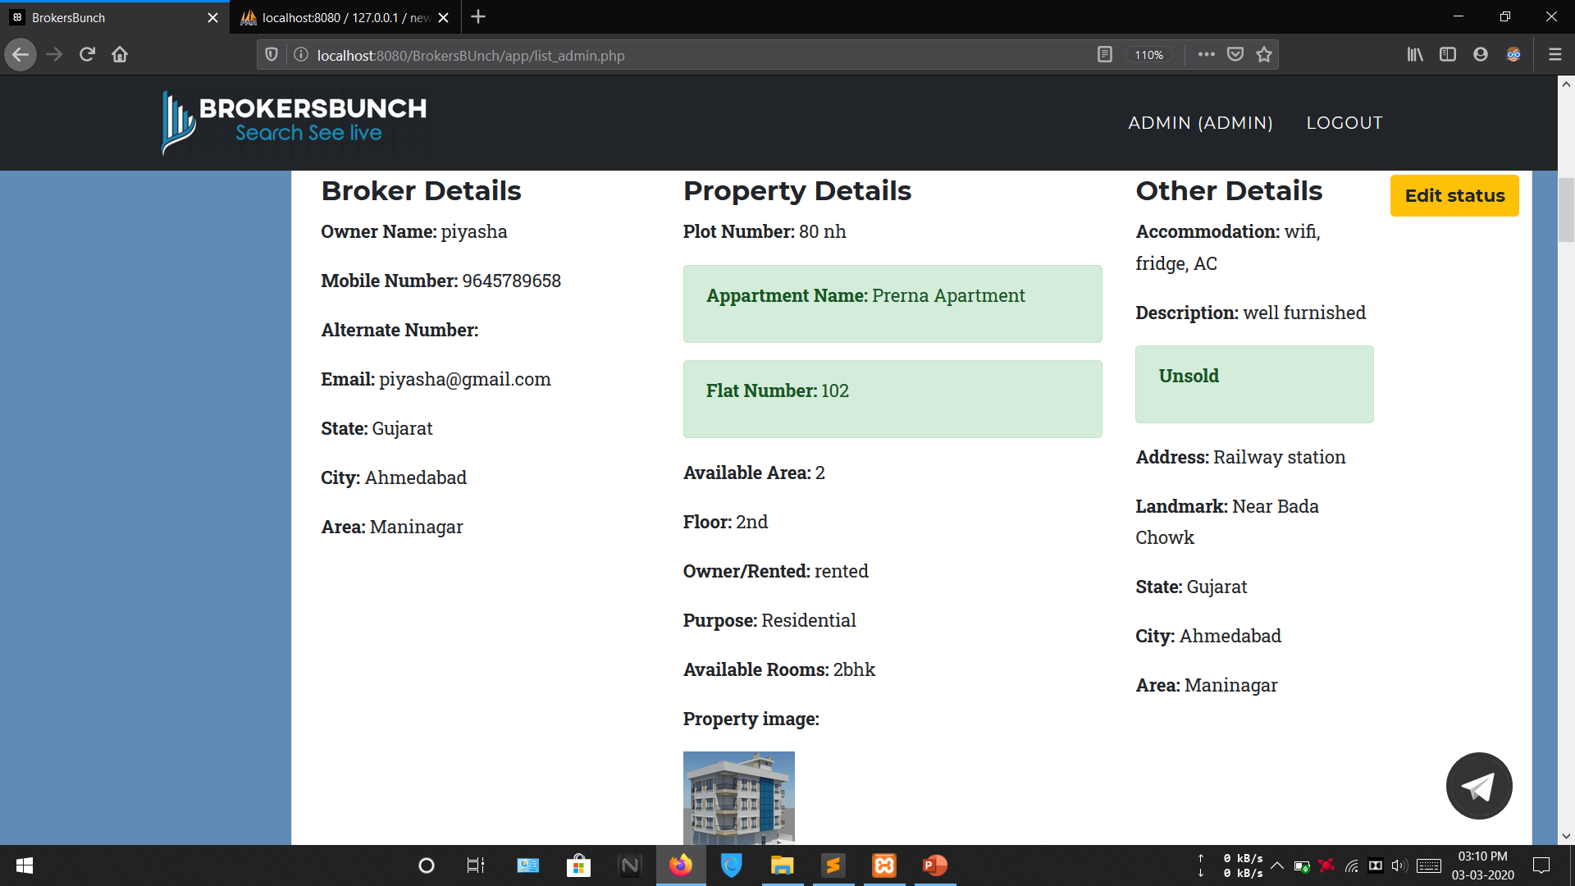

Slide 37
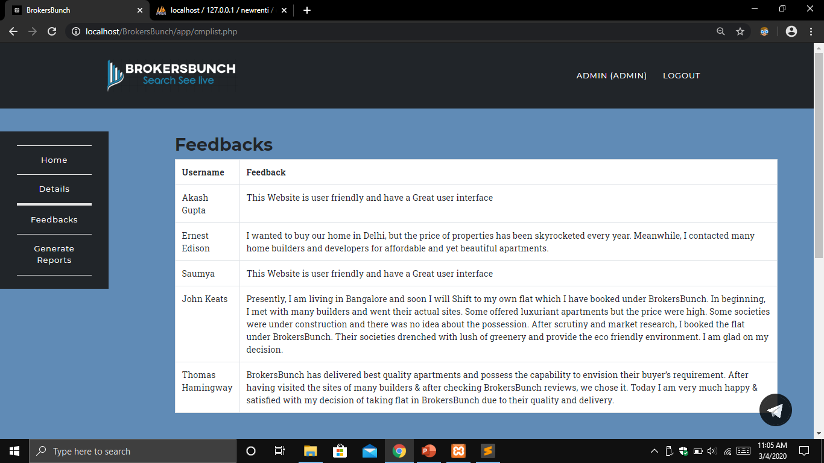

Slide 38
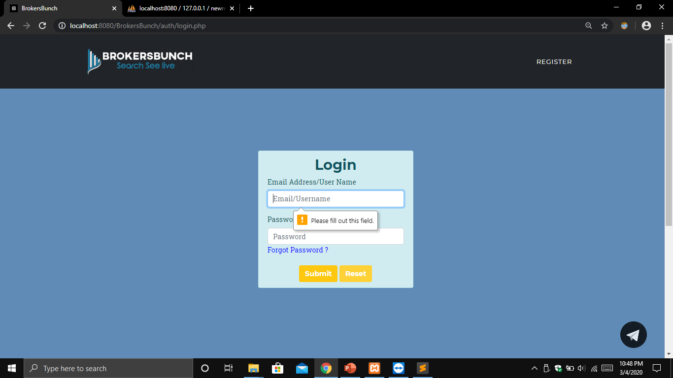

Slide 39


Slide 40
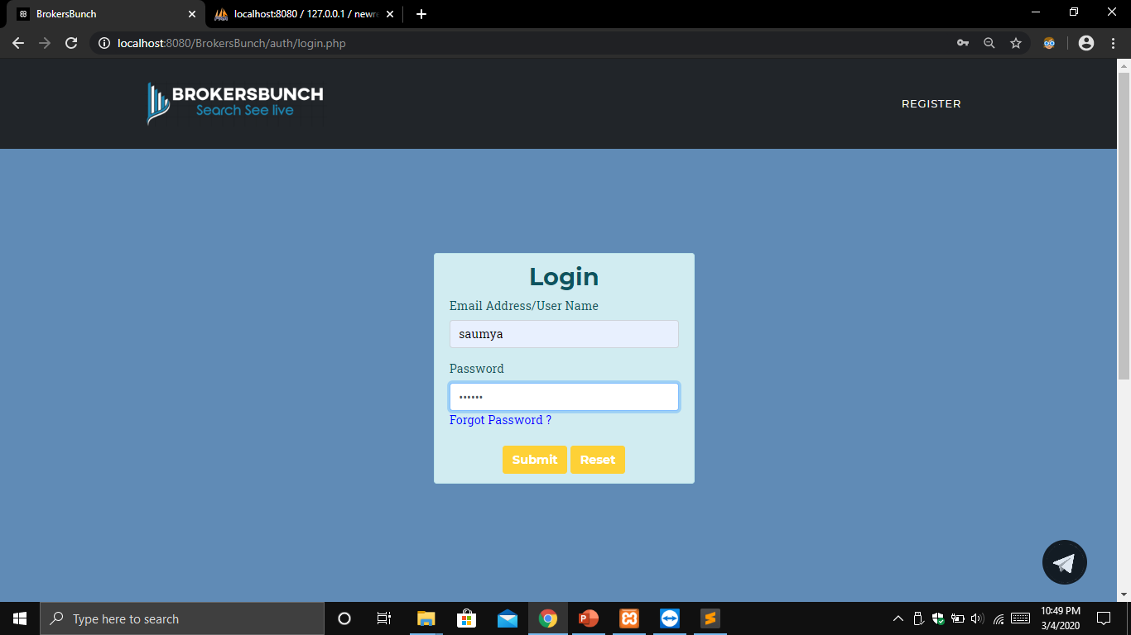

Slide 41
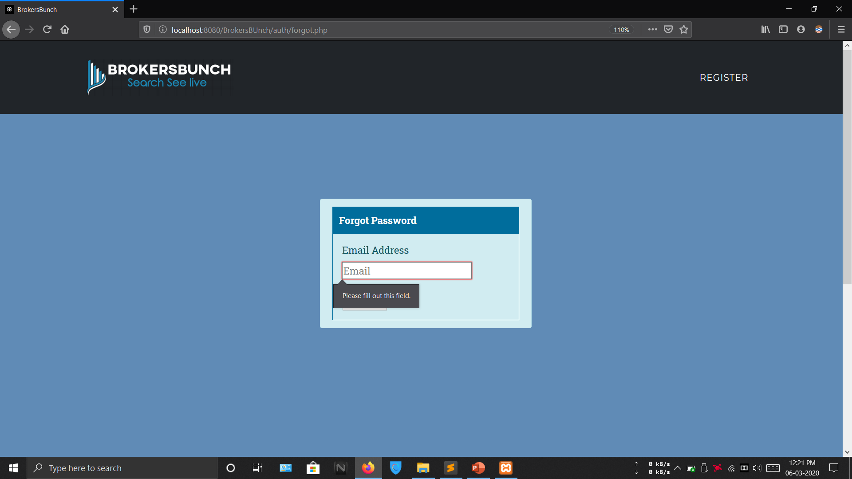

Slide 42
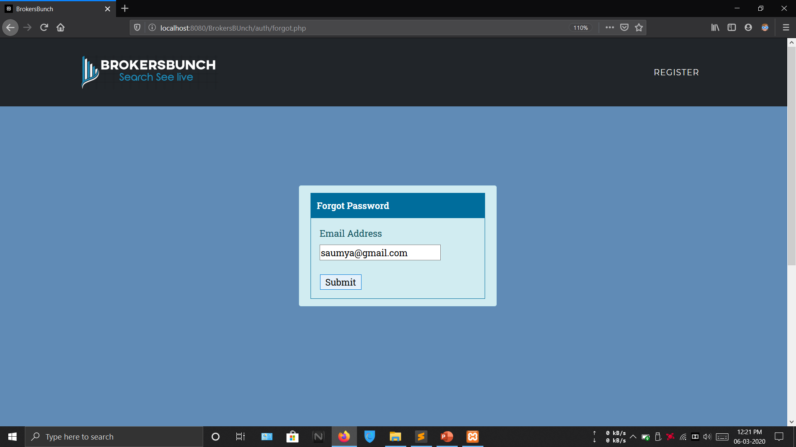

Slide 43
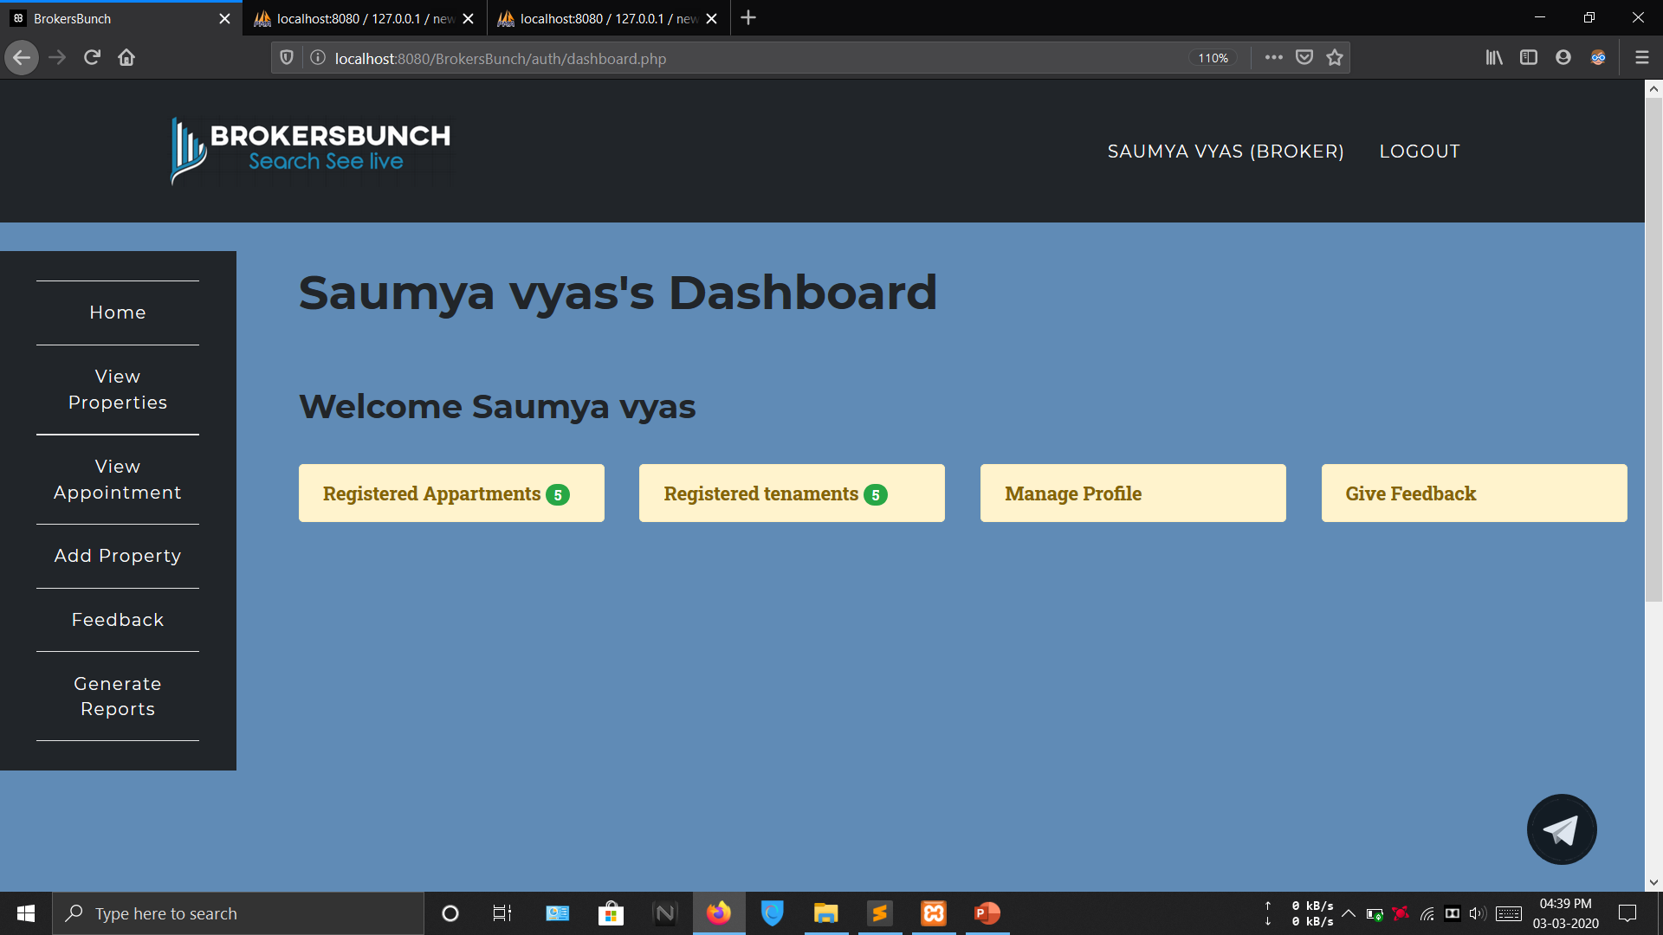

Slide 44
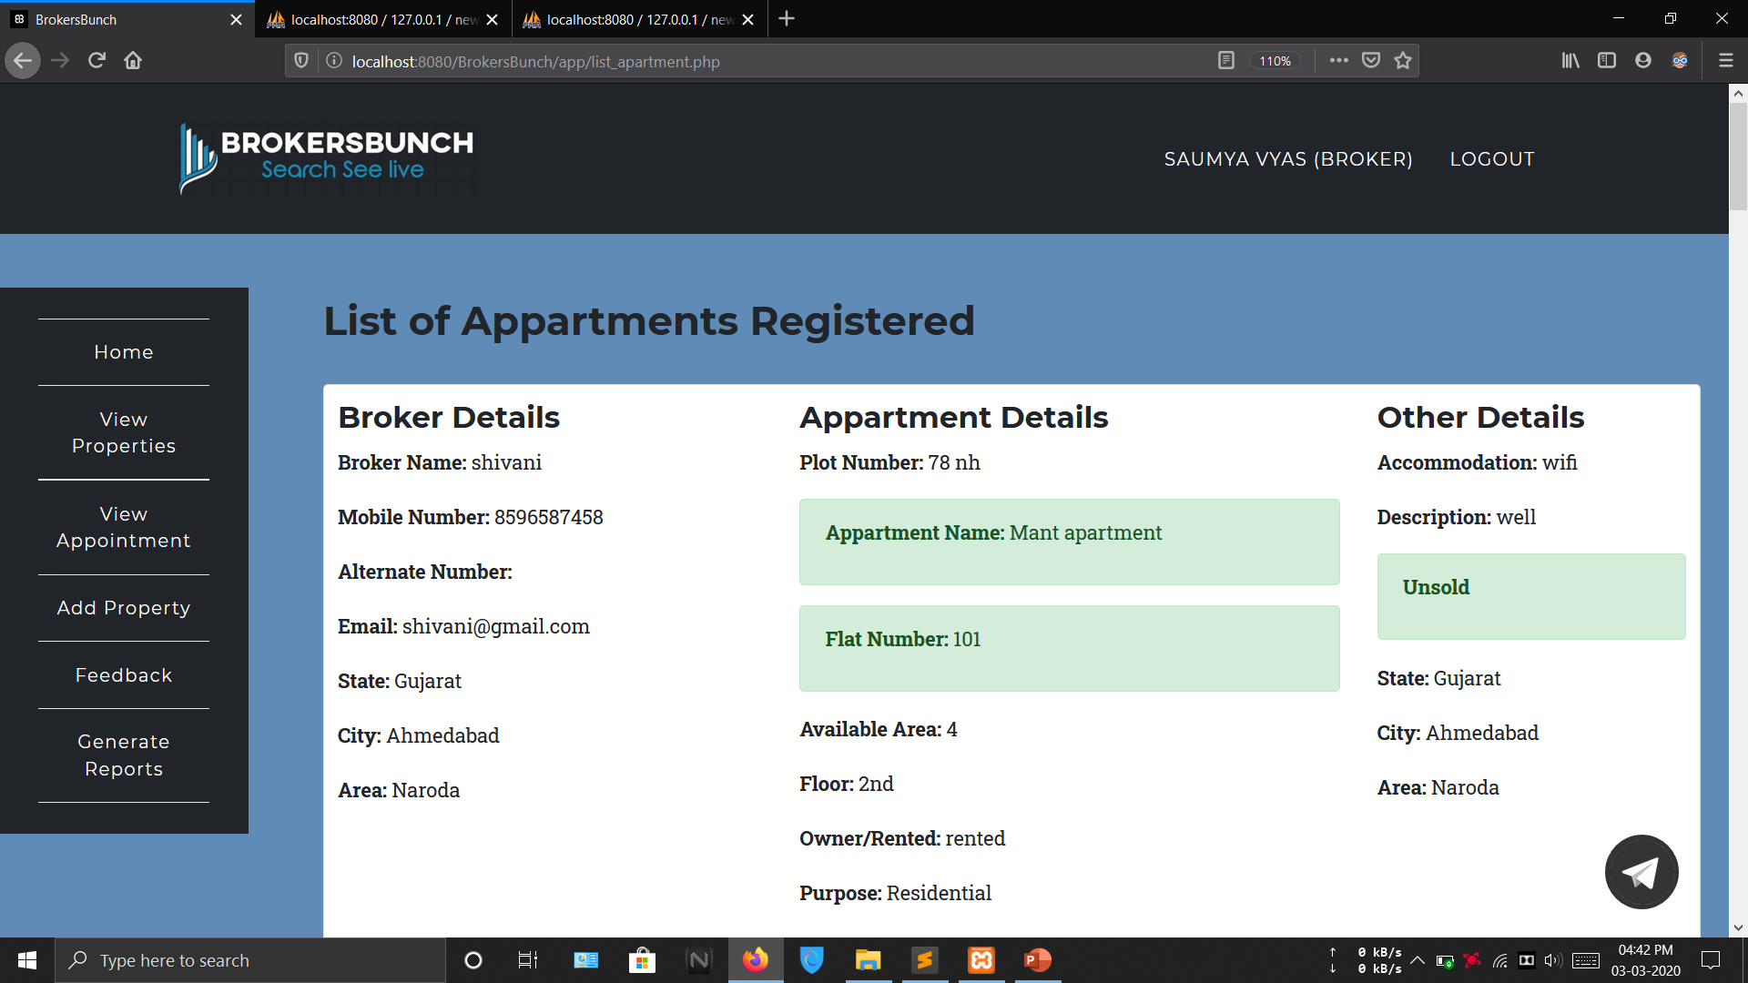

Slide 45
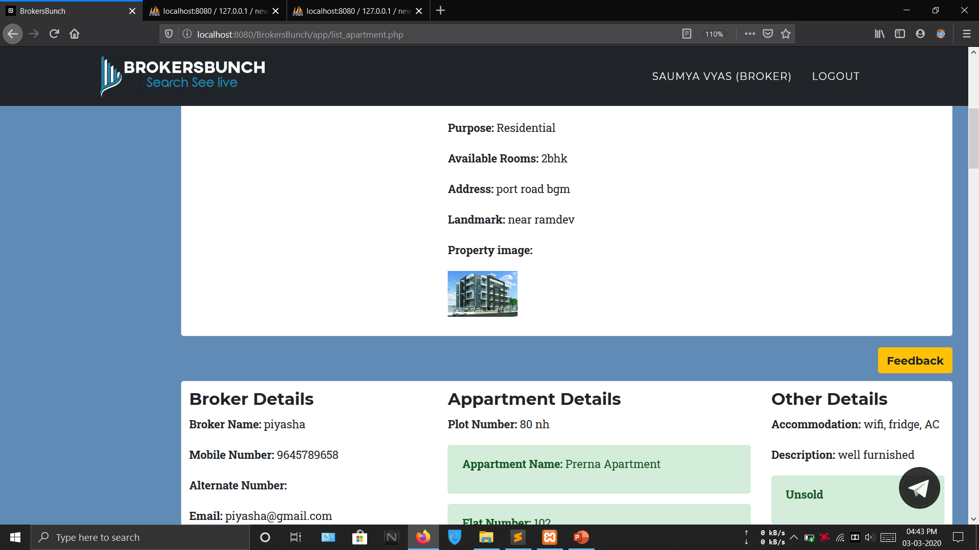

Slide 47
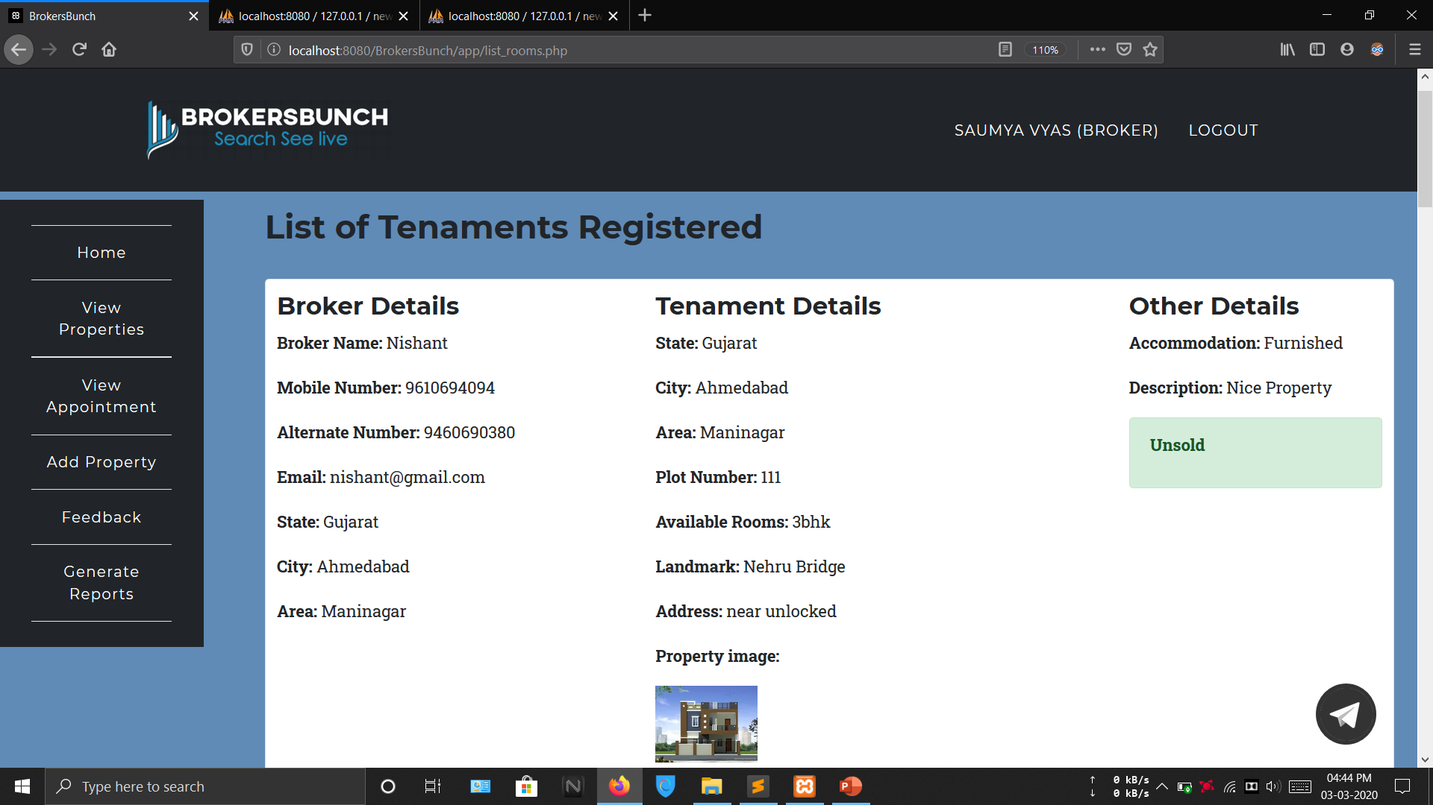

Slide 49
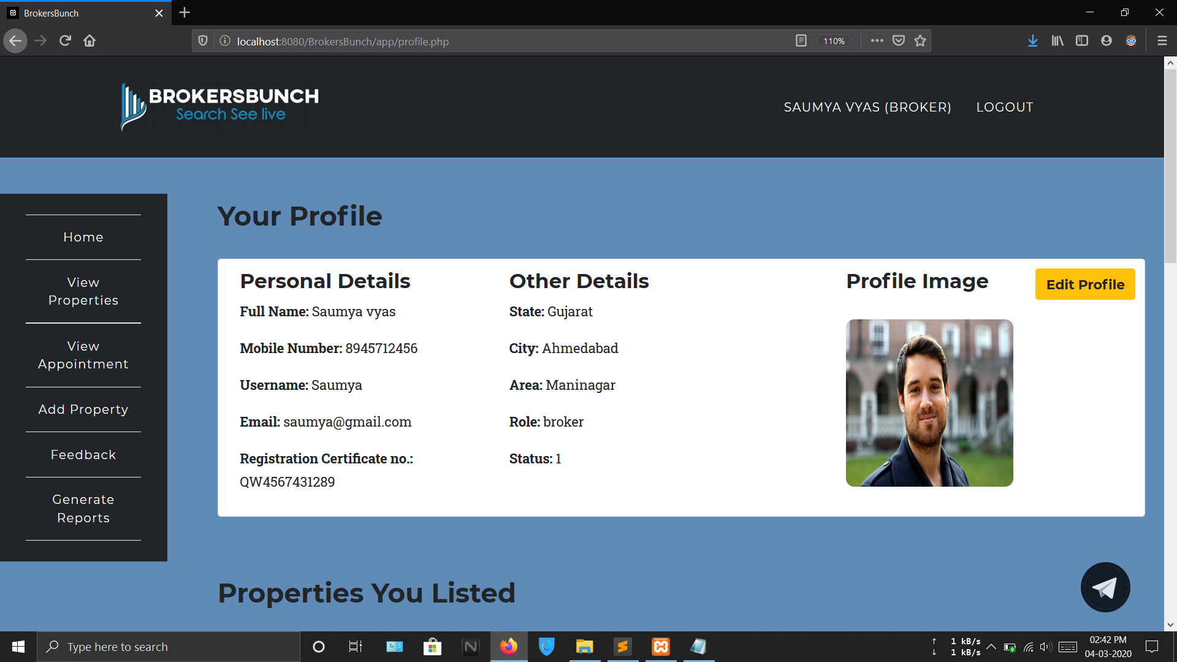

Slide 50
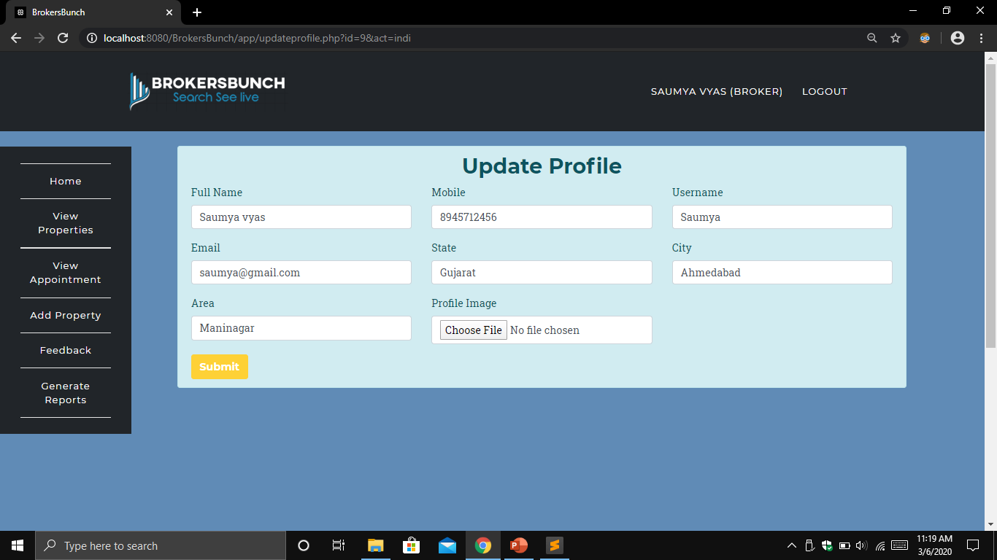

Slide 51
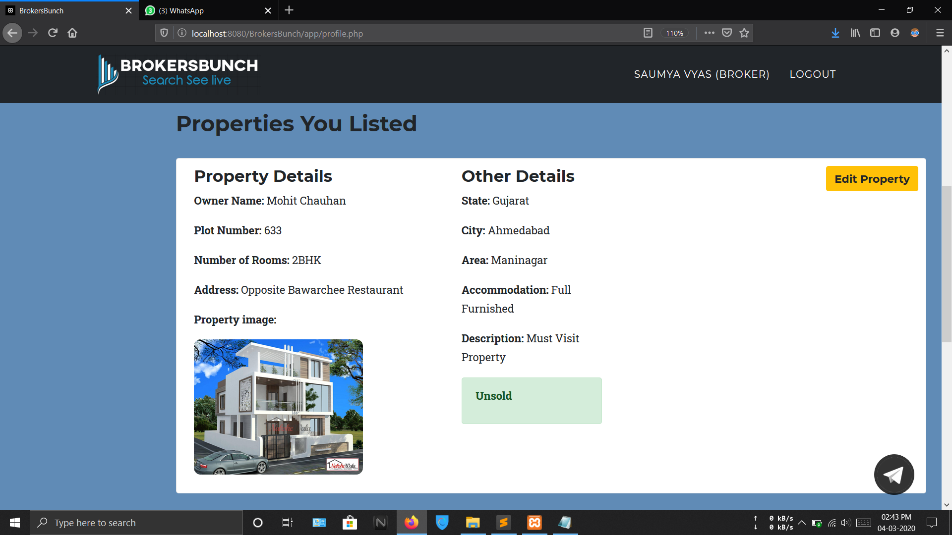

Slide 52
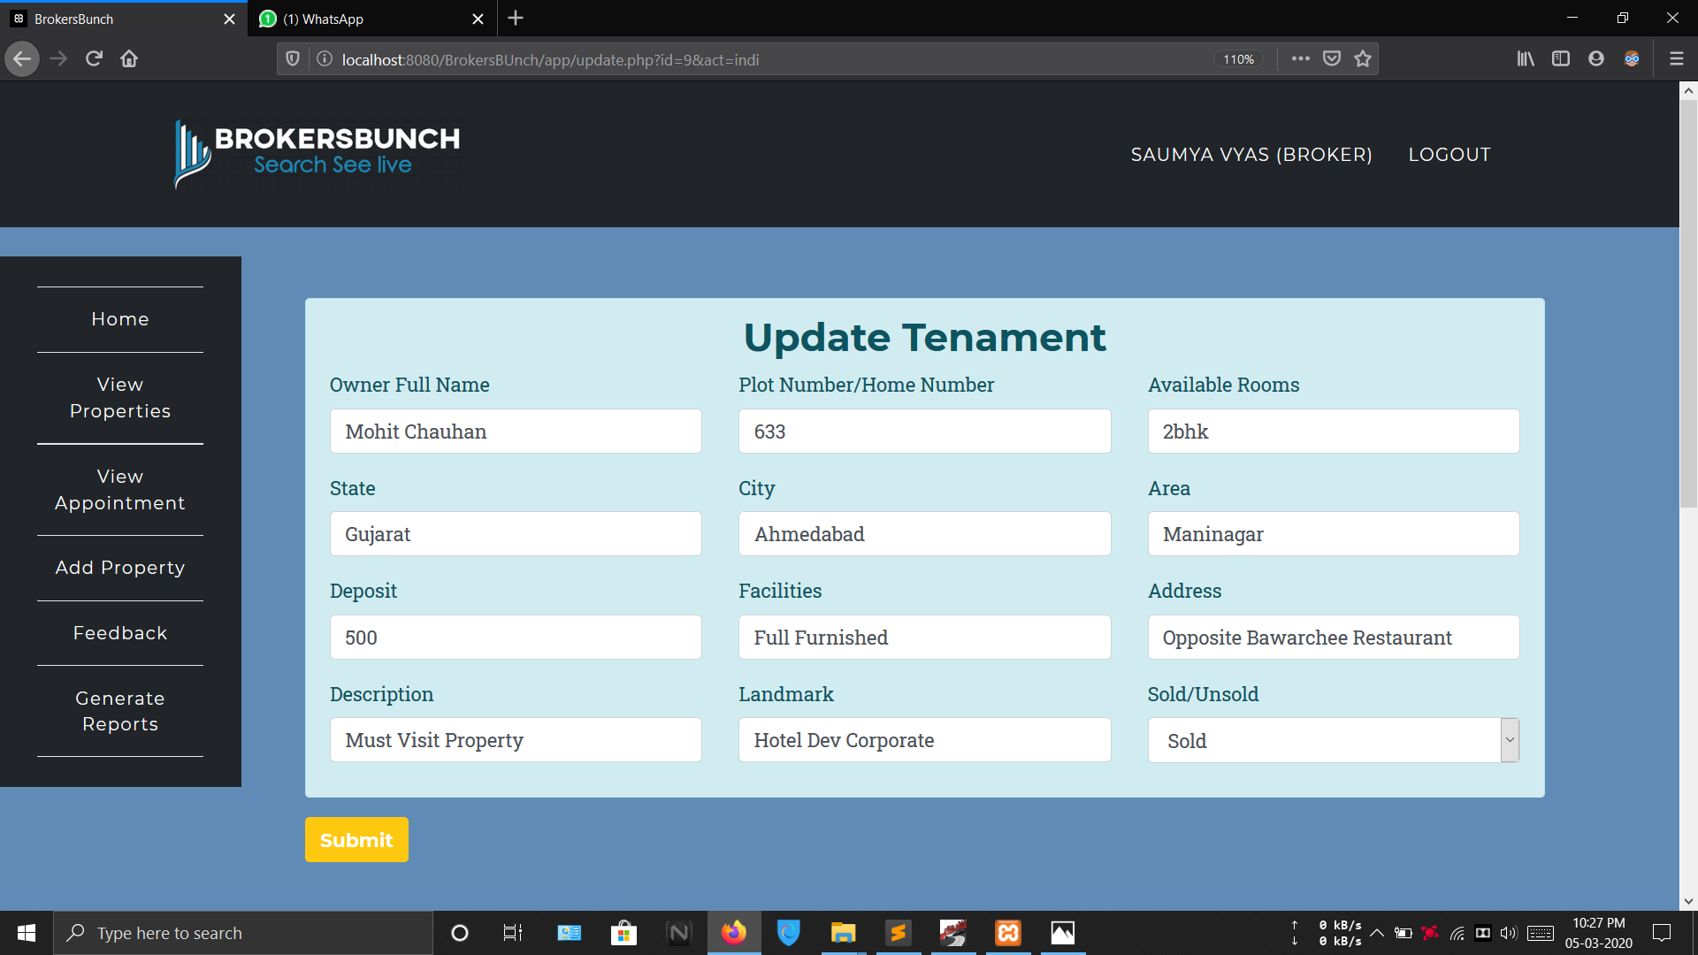

Slide 53
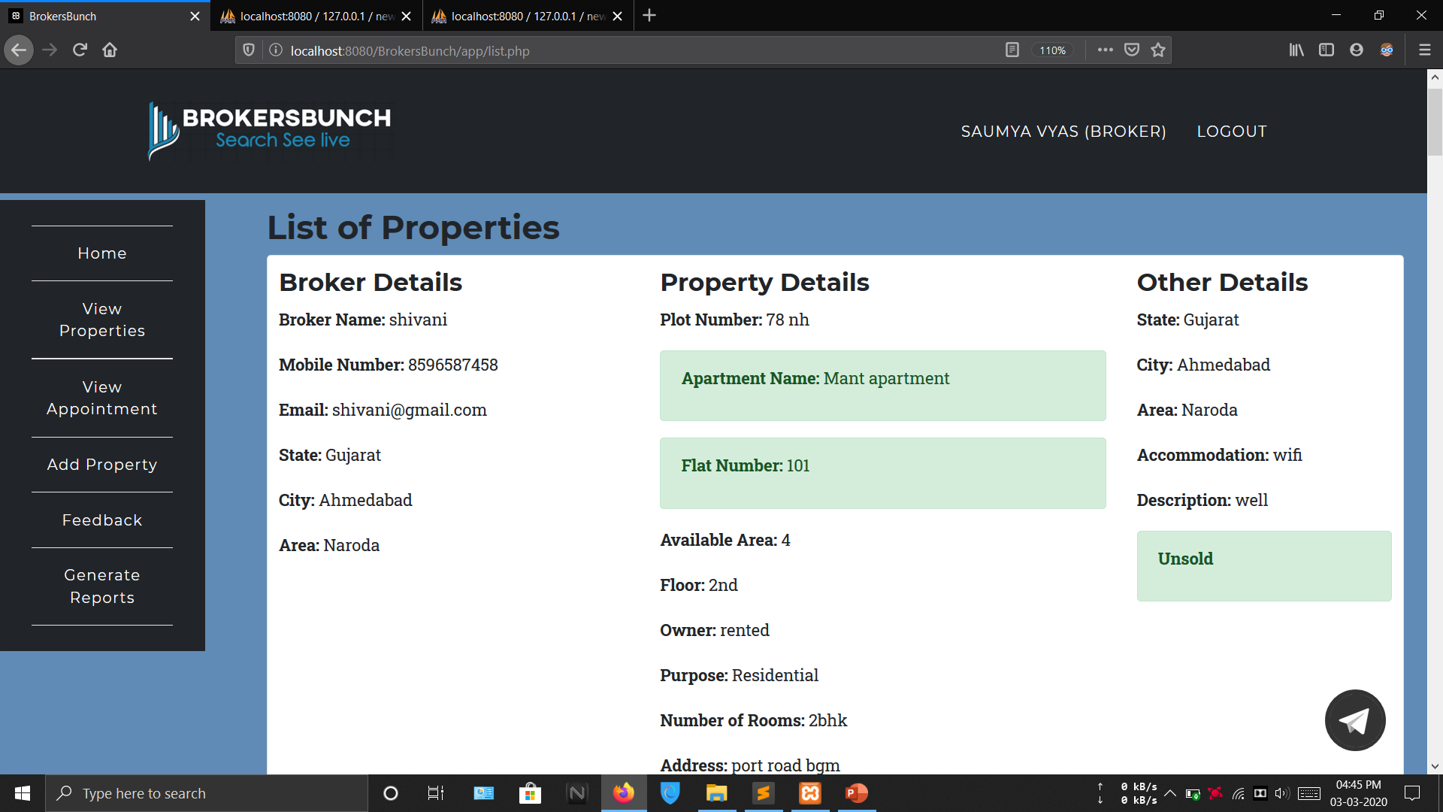

Slide 54
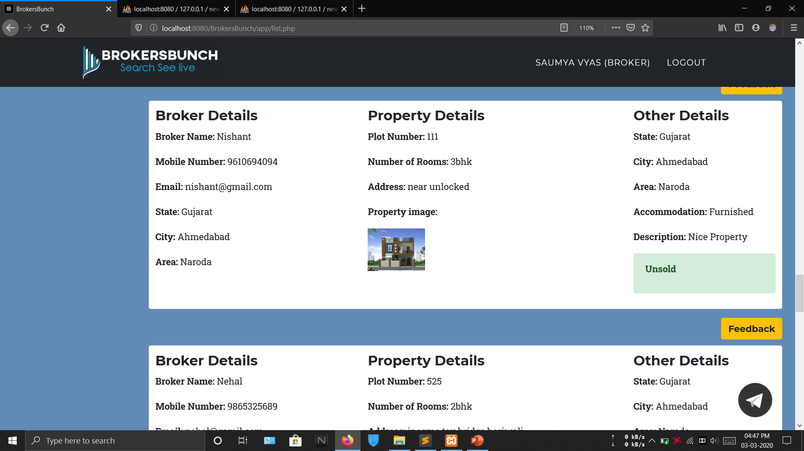

Slide 55
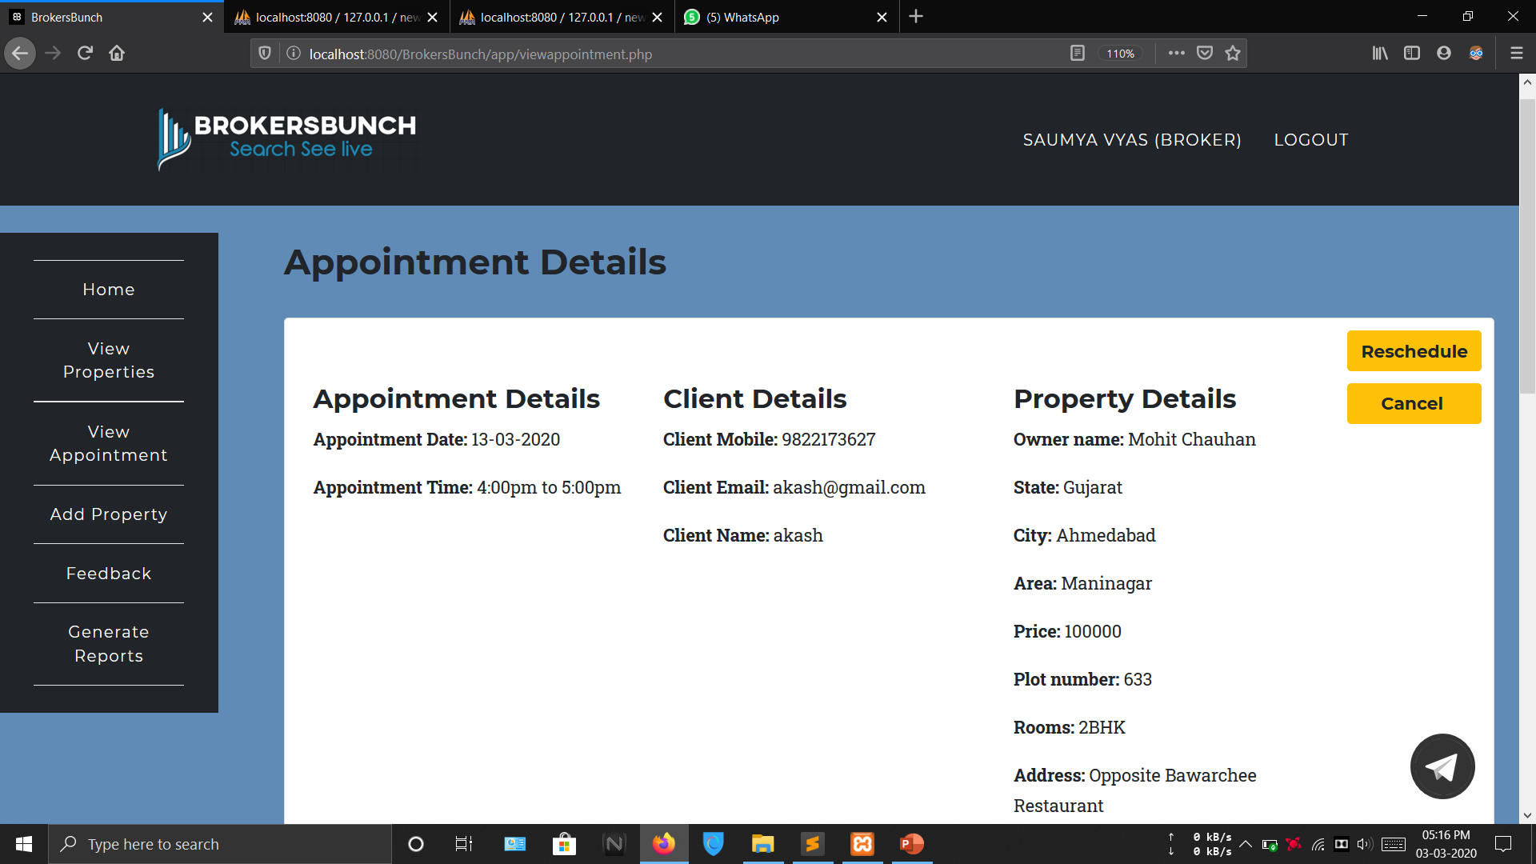

Slide 56
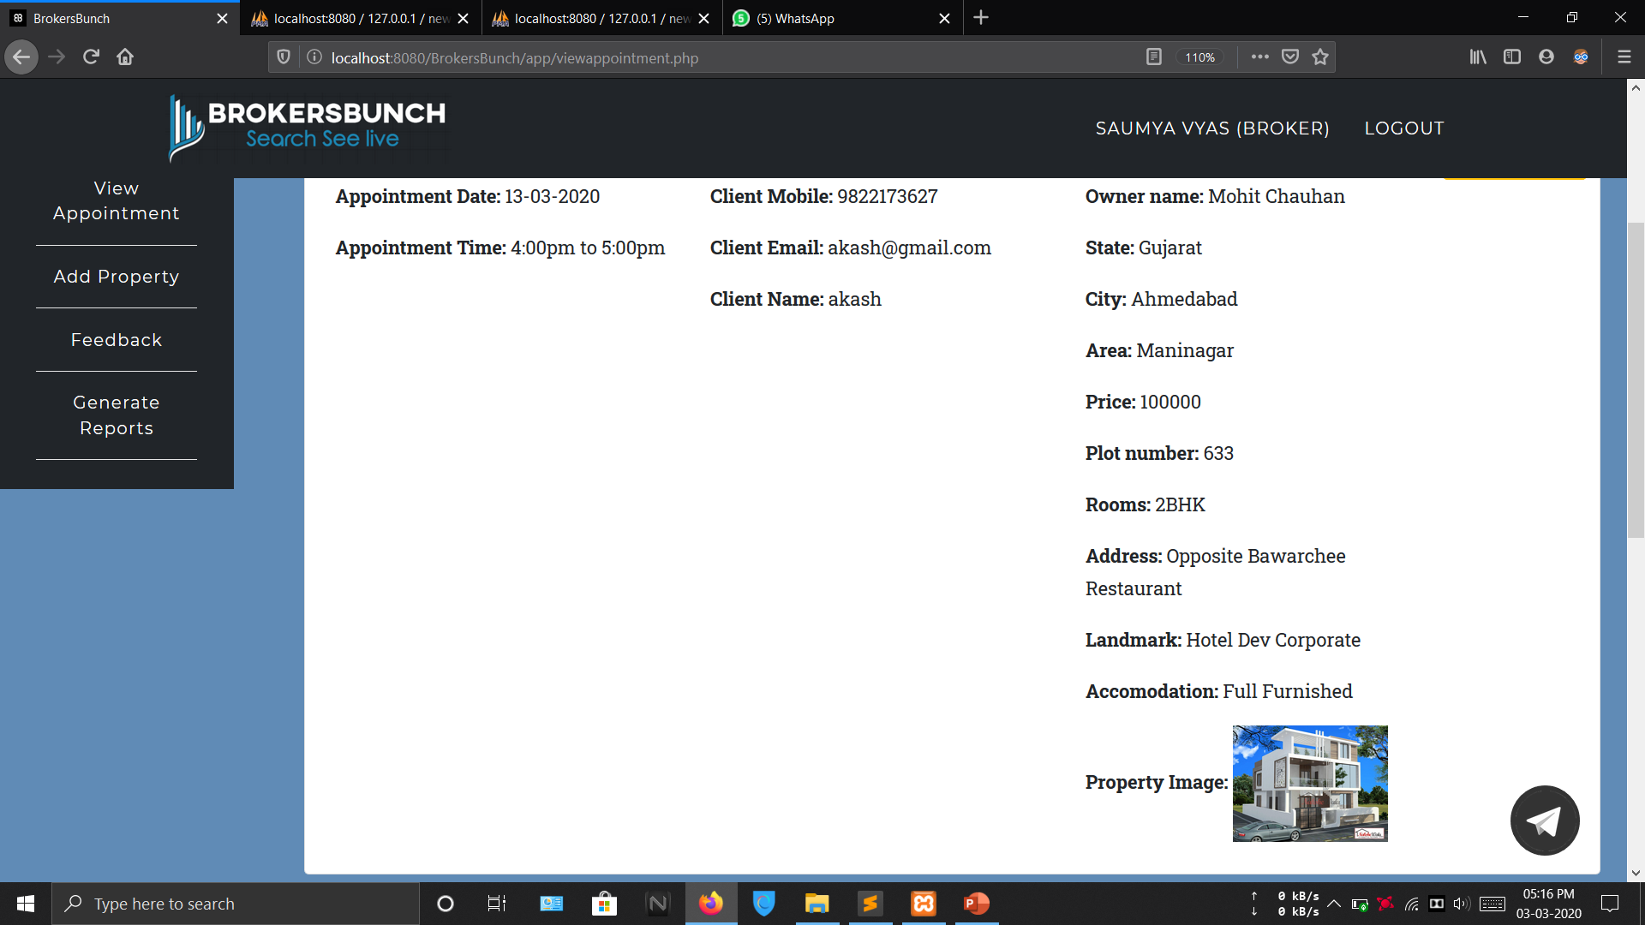

Slide 57


Slide 58
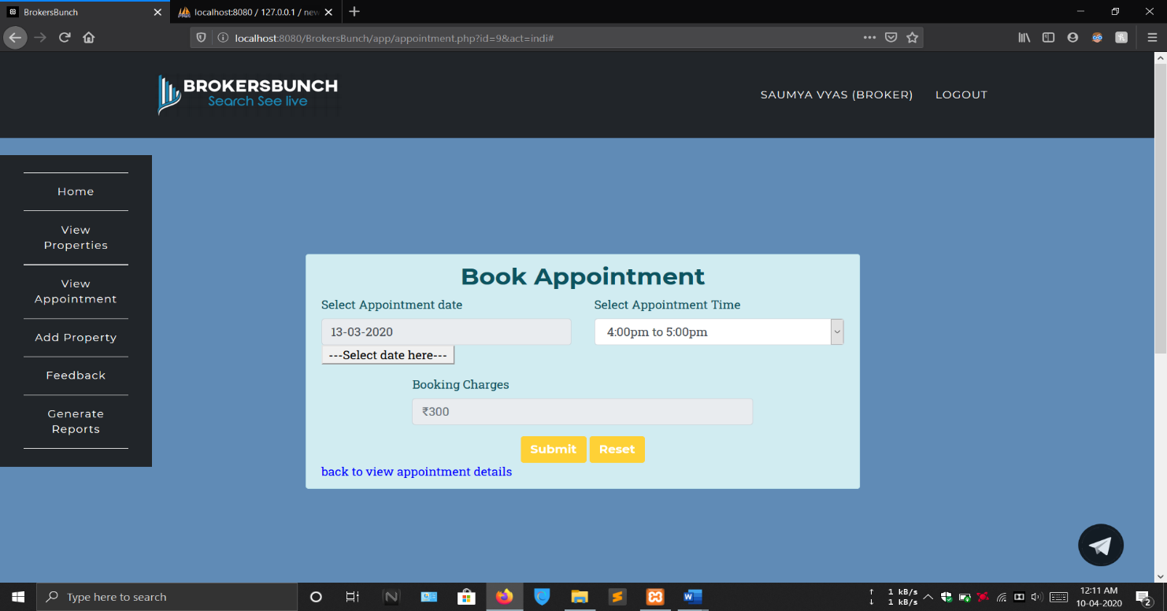

Slide 59
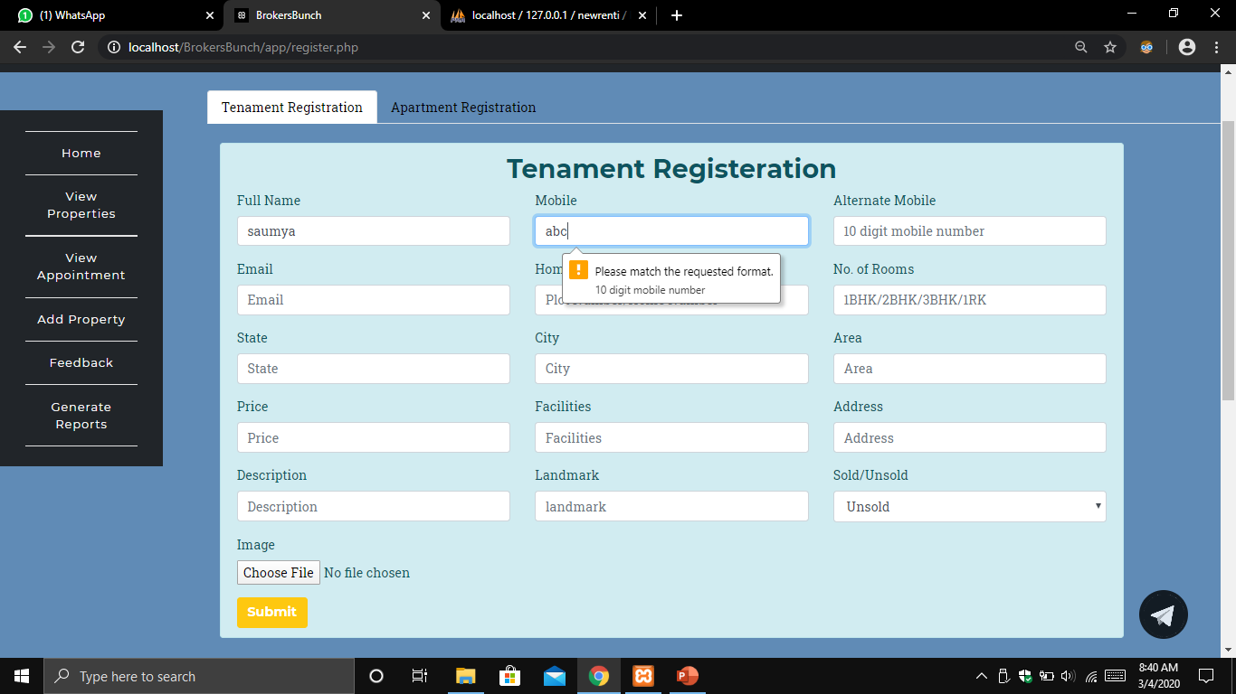

Slide 60
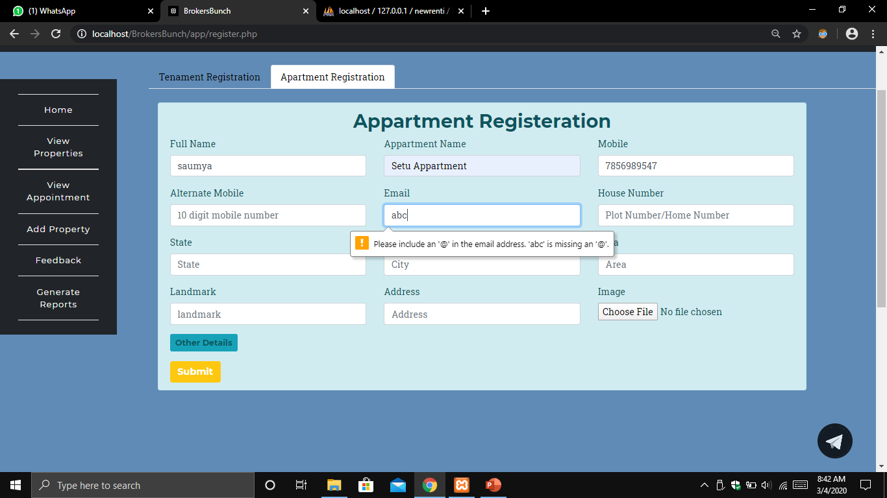

Slide 61
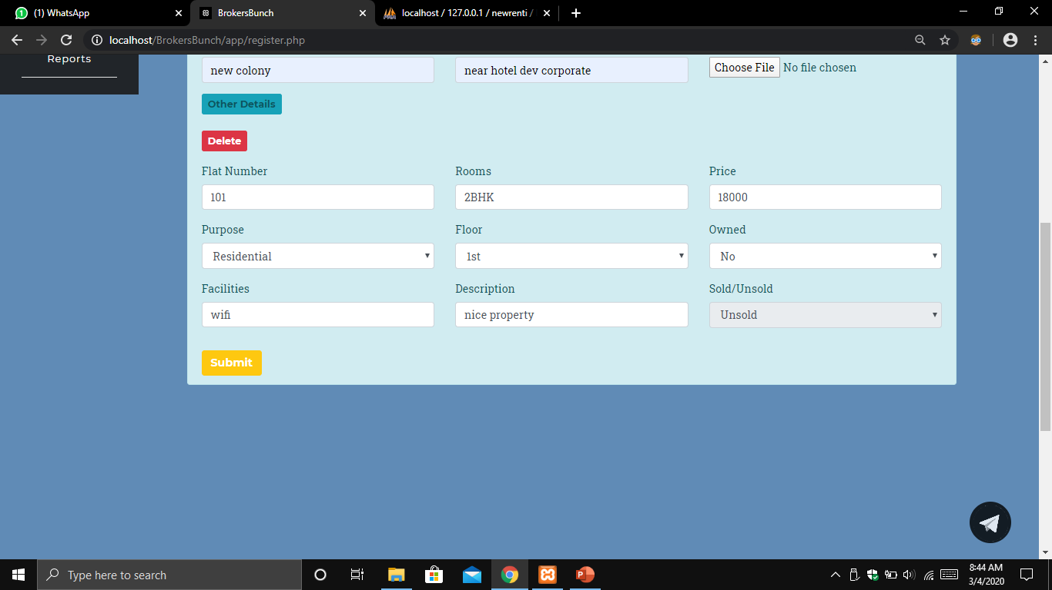

Slide 62
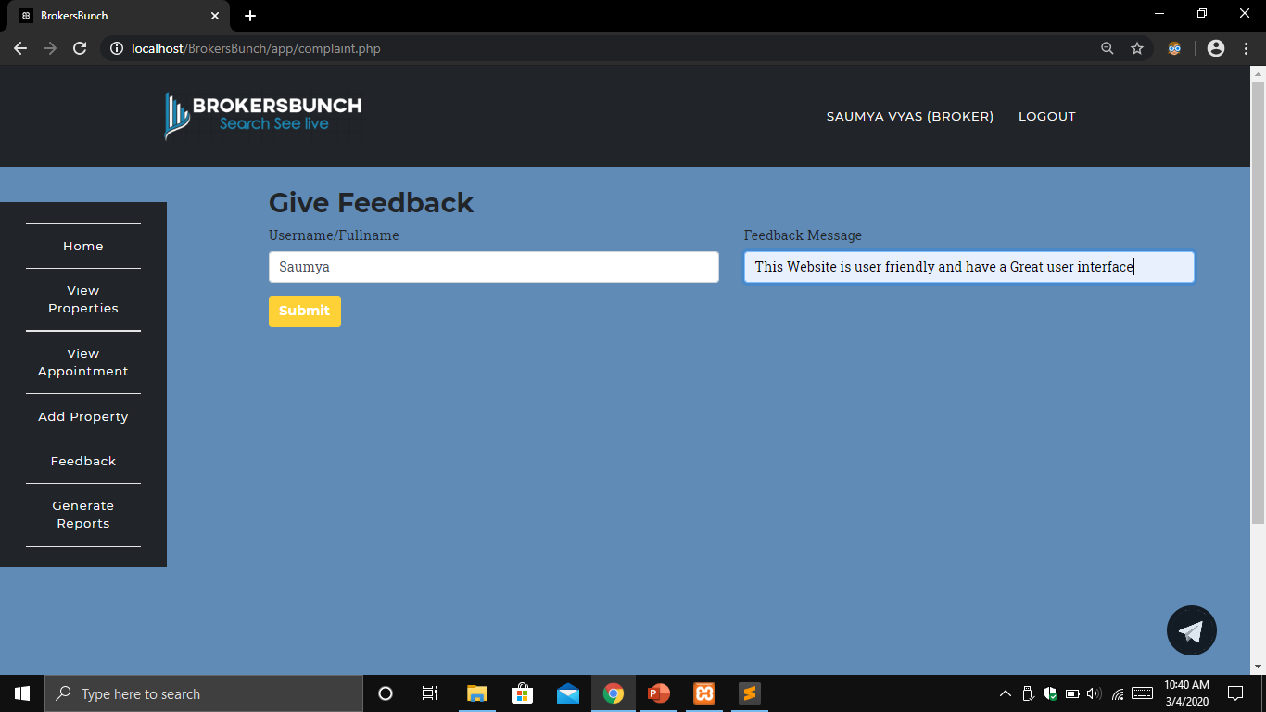

Slide 63
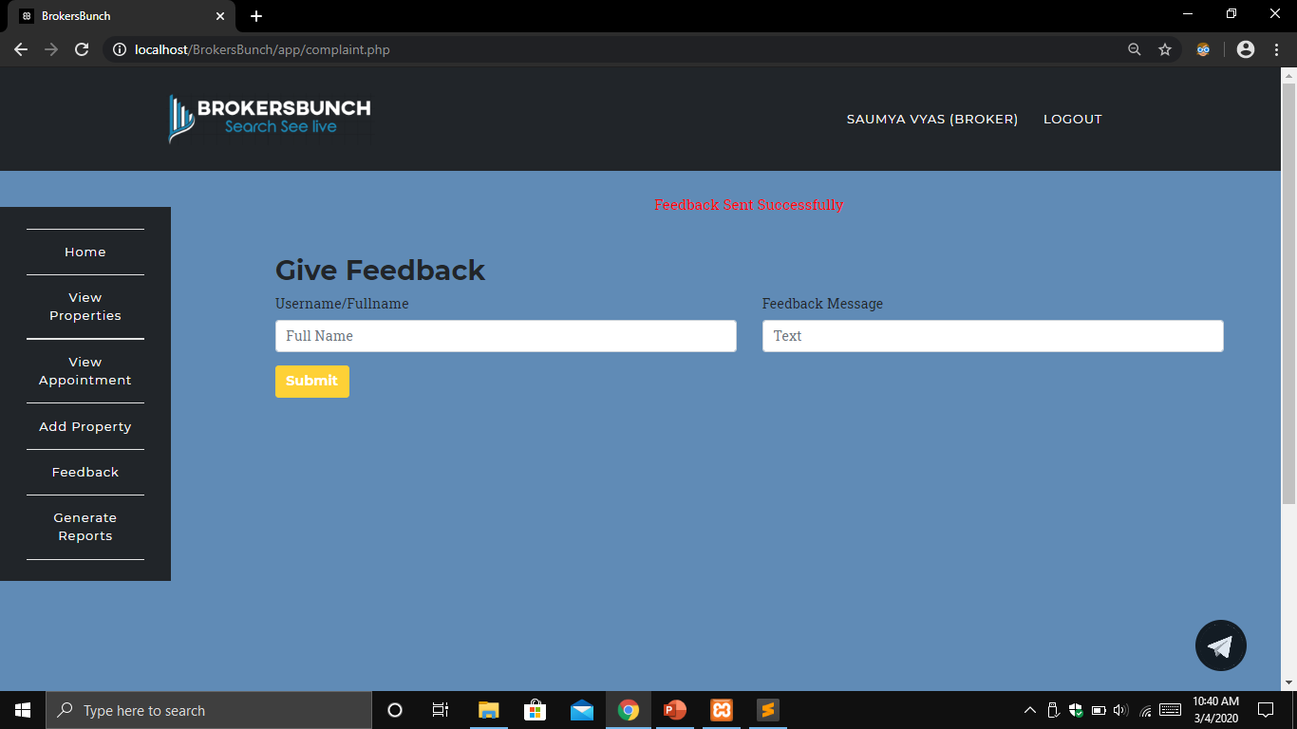

Slide 64


Slide 65


Slide 66


Slide 67


Slide 68


Slide 69


Slide 70


Slide 71


Slide 72


Slide 73


Slide 74
Reports
In this tab entities of the website can generate the report and save them.
By clicking on the generate report tab entities will be directed the reports section. In this section the can generate report by fetching data from the database according to their requirements.
Different combination as per our working of website is considered and reports are generated here.

Slide 75


Slide 76


Slide 77


Slide 78


Slide 79


Slide 80


Slide 81


Slide 82


Slide 83


Slide 84


Slide 85


Slide 86


Slide 87


Slide 88


Slide 89


Slide 90


Slide 91


Slide 92


Slide 93


Slide 94


Slide 95


Slide 96


Slide 97


Slide 98


Slide 99


Slide 100


Slide 101


Slide 102


Slide 103


Slide 104


Slide 105


Slide 106


Slide 107


Slide 108


Slide 109


Slide 110


Slide 111


Slide 112


Slide 113


Slide 114


Slide 115


Slide 116


Slide 117


Slide 118


Slide 119


Slide 120


Slide 121


Slide 122


Slide 123


Slide 124


Slide 125


Slide 126


Slide 127
THANK YOU

